Slide 1

Treating hallucinations: integrating cognitive, metacognitive and compassion based elements.
Professor Douglas Turkington, Newcastle University. Trauma Dissociation and Psychosis conference, Kristiansand, Norway 22nd-24th May, 2019.
Assessment of Cognitive Therapy
Instead of Neuroleptics

Slide 2
Acknowledgements
Rob Dudley, Psychosis pathway lead at NTW, UK
Tony Morrison, Chief investigator on the ACTION, FOCUS trials, Manchester, UK.
Filippo Varese, Director of the Complex Trauma and Resilience Research Unit. Manchester, UK.
Eduardo Aguilar, Consultant, Department of Medicine, Valencia University, Spain.
Helen Spencer, Doctoral Researcher at NTW, UK
Lucy Stevens, Clinical Psychologist in EIP/Psychosis, TEWV, UK
Sarah Kopelovich, Professor of CBT psychosis, Washington State University.

Slide 3
Questions to be considered
1. Is hallucination a signature symptom of traumatic psychosis? Results of a cluster analysis using PANSS elements and CTQ in an unmedicated sample
2. Can the key components of the integrated model (cognitive, metacognitive and compassion focused) be described. Results of an analysis of key techniques and outcomes.
3. Is traumatic psychosis a good outcome group when treated with the integrated approach?
4. Is there a biological model for CBT’s action in traumatic psychosis?

Slide 4
1. Introduction: sub-groups of schizophrenia (Kingdon and Turkington, 2005)
Traumatic Psychosis
Drug-related Psychosis
Sensitivity Disorder
Anxiety Psychosis
Catatonia
Notes:
After 30 years of clinical experience through an analysis of formulations we described 5 fairly discrete psychotic presentations within schizophrenia.

Slide 5
Traumatic Psychosis: a chronology
Dissociative Psychosis (van der Hart, 1993)
Positive symptom schizophrenia (Ellason and Ross, 1997)
Obsessional Psychosis (Turkington, 1997)
PTSD with psychosis (Seedat, 2003)
Traumatic psychosis (Kingdon and Turkington, 2005)
Borderline Psychosis (Schroeder, 2013)

Slide 6
Sensitivity Disorder (‘neurodevelopmental schizophrenia’) is a different disorder
Schizoid personality/ genetic and/or biological vulnerability
Prominent primary negative symptoms/ cognitive deficit
Gradual onset in teens
Minor stress precipitates episodes
High EE by carers – criticism/over protection
Ideas/delusions of reference, thought broadcasting, running commentary voices and paranoia frequent
Optimal medication response for positive symptoms.

Slide 7
Traumatic Psychosis (Kingdon and Turkington, 2005)
Characteristics
Voices –multiple, critical, violent or sexual content (often command)
Visual hallucinations: ‘thematic’ flashbacks
Somatic hallucinations: linked to sexual trauma
Trauma history (with re-traumatisation)
Substance misuse.
Features of emotional instability.
Dissociation usually present
Depression, shame and anxiety prominent.
Often revolving door patients.
Often demonstrate poly-pharmacy.

Slide 8
Hassan and De Luca (2014)
42% of 186 patients with schizophrenia spectrum disorder resistant to antipsychotic medication.
Cumulative lifetime adversities have an independent effect on antipsychotic resistance.

Slide 9
Stevens et al, 2018 the relationship between trauma and psychosis
“there are four clinical manifestations of trauma in psychosis”
Childhood trauma is followed by re-traumatization and eventual triggering of the psychotic episode by a further trauma.
Neurodevelopmental psychosis (schizophrenia) leads to trauma due to vulnerability in community settings
Psychotic PTSD where an adult trauma presents in a modified format with trauma congruent psychotic symptoms
Psychosis with low levels of insight leads to post-psychotic PTSD which acts as a maintaining factor

Slide 10

2. Is hallucination a signature symptom of traumatic psychosis?
Results of an explanatory cluster analysis using PANSS elements and CTQ in an unmedicated sample from the ACTION trial (Morrison et al, 2016)

Slide 11
93.3% of the total sample had suffered a form of childhood maltreatment (abuse or neglect)
2 CTQ clusters
  Cluster 1 (N=31): The “Neglect” Cluster
    low total score but rated significantly* higher on emotional neglect and similar levels of physical neglect to cluster 2
  Cluster 2 (N=14): The “Abuse” Cluster
    significantly* higher mean total score and rated significantly higher on all types of abuse, with similar levels of physical neglect to cluster 1
Supports distinction between abusive and neglectful experiences
  Calculated according to largest difference in error co-efficient
  Validated using MDS and random split of the data
*Confirmed by independent samples t-test to 0.5 level
Notes:
2 clusters emerged, cluster 1 which had the highest number of participants, 31, had a significantly higher emotional neglect score than cluster 2 but was significantly lower on everything else (except physical neglect which appeared to be present to a similar level throughout the sample) compared to cluster 2
Cluster 2 was named the abuse cluster as this was characterised by a significantly higher CTQ score and significantly higher on all forms of abuse
This supports a distinction between abusive and neglectful experiences, and this model was arrived at from examining the error co-efficient, whereby the largest increase was at the 2-cluster level. There were also a number of methods used to validate the clusters, including randomly splitting the data and examining the distribution (which was similar showing robustness) and MDS

Slide 12
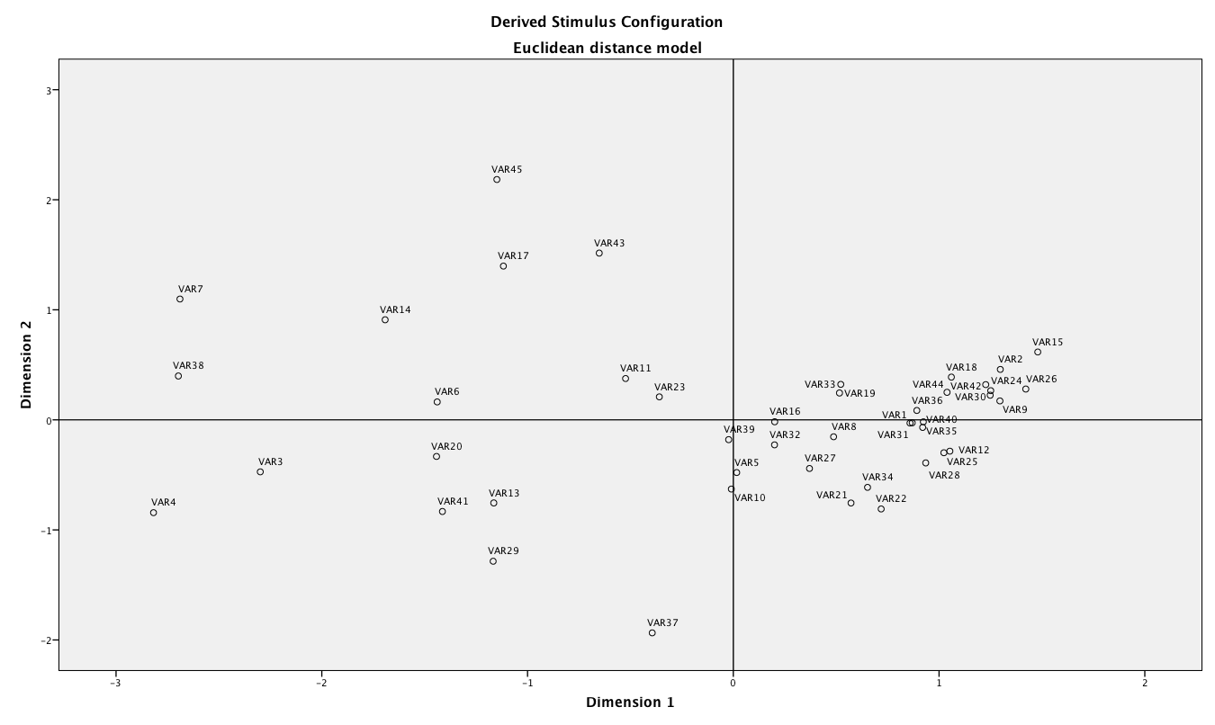
MDS Euclidean Distance Model for CTQ
Cluster 2
(N=14)
Cluster 1
(N=31)
Diversity across types
Abuse
Neglect
Notes:
So this was the MDS model that was produced. Not only does this approach allow for further validation of the clusters in terms of highlighting their seperateness in space, but also helps to further define the clusters in terms of how they appear along certain dimensions
For example, dimension one was abuse/neglect dimension, or rather neglect dimension whereby cluster 1 scored high on this and cluster 2 low on this. Subsequently seems that those who scored high on neglect scored low on abuse, and the reverse, which produced 2 distinct groups.
Uncertain as to what contitutes the other dimension, which rather simply seems to represent variation within ratings between the scores, for example, are positioned similarly in relation to the vertical axis and have little variation across scales, whereas for cluster 2, there appear to be multiple types of abuse occurring together so this spread could simply represent the diversity

Slide 13
Do those who have experienced abuse (vs. those who have experienced neglect) have a different symptom profile, in line with what is expected for traumatic psychosis?
Figure 2: Bar chart showing the mean scores of the trauma clusters for each of the assumptions of traumatic psychosis
Notes:
This displays the findings from the t-tests to compare symptoms across the two clusters. A series of t-tests and found only 2 significant findings in line with what is expected – that is those on cluster 2 of CTQ (higher trauma score) reported higher levels of positive symptoms overall and hallucinations. However, no other significant findings.

Slide 14
Unexpected findings?
Higher unusual beliefs score in cluster 2
Higher mannerisms and posture score in cluster 1
Figure 3: Bar chart summarising other significant differences in PANSS scores between the clusters
Notes:
So there were also some unexpected findings

Slide 15
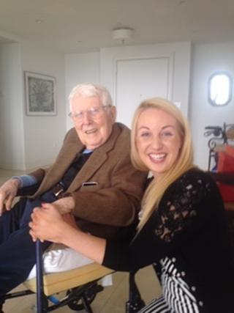
3. Can the integrated model (cognitive, metacognitive and compassion focused) be described?

Slide 16
Trauma and psychosis formulation
Abuse triggers
Voices, visions
Anxiety, shame,
dissociation
Thought suppression, worry,
self harm
“It is a demon”
Notes:
16
16

Slide 17
CBT elements
Recognise and manage abuse related triggers
Normalise and formulate
Timeline work
Effective coping strategies
Questioning and testing of delusion
Reality testing of voices, visions, somatic sensations
Grounding for dissociation
Rational responses and imagery around resilience
Processing the traumatic memories (exposure/imagery)
Schema work on dangerousness of the world and inability to cope.

Slide 18
metacognitive and compassion based elements
Reduce thought suppression
Worry periods and worry postponement
Reduce rumination
Tackle meta-beliefs about dangerousness of voices
Tackle meta-beliefs about supernatural nature of voices.
Activate self nurture
Compassion based techniques for critical voices
Self-compassion to reduce shame
Compassionate imagery

Slide 19
CBT components
1) Agreed goal.
2) Homework.
3) Formulation type (A-B-C, maintenance or timeline)
4) Cognitive Techniques (normalising, evidential analysis, cognitive restructuring, advantages and disadvantages, alternative explanations, core belief/schema change.
5) Behavioural techniques (survey planning/review, safety behaviours/behavioural experiments, exposure, reducing social isolation, increasing activity and relapse prevention.
6) Meta cognitive techniques (positive/negative meta beliefs, worry/rumination periods and postponement and attentional strategies).

Slide 20
Intervention Components (Frequency)
Percentage of times a homework task was completed 51% (82/159 sessions).
Maintenance formulation (31%) 50/159.
Problems/goals 25% (39/159).
Cognitive restructuring/alternative explanations (21%) 33/159.
Advantages / disadvantages (20%) 33/195.
Longitudinal formulation (13%) 21/159.
Normalising (10%) 16/159.

Slide 21
Intervention Components Frequency
Safety behaviours (15%) 24/159.
Evidential analysis (11%) 18/159.
Metacognitive strategies (10%) 16/159.
Relapse prevention (8%) 13/159
Survey (5%) 9/159
Metacognitive beliefs (4%) 6/159.
Attentional strategies (2%) 3/159.

Slide 22
Summary of key techniques
Having an agreed problem, doing homework and making sense of the voices/delusions using a formulation were the most common techniques used.
Crucial change strategies included developing cognitive restructuring/generating alternative explanations, exposure and doing behavioural experiments to reduce safety behaviours.
Metacognitive techniques were widely used but compassion based techniques were not deployed by the therapists in this study.

Slide 23

4. Is traumatic psychosis a good outcome group when treated with the integrated approach?

Slide 24
Results of the ACTION study
….an RCT of CBT vs TAU in people with schizophrenia spectrum disorder who were antipsychotic medication refusing….(Morrison et al, 2014).

Slide 25
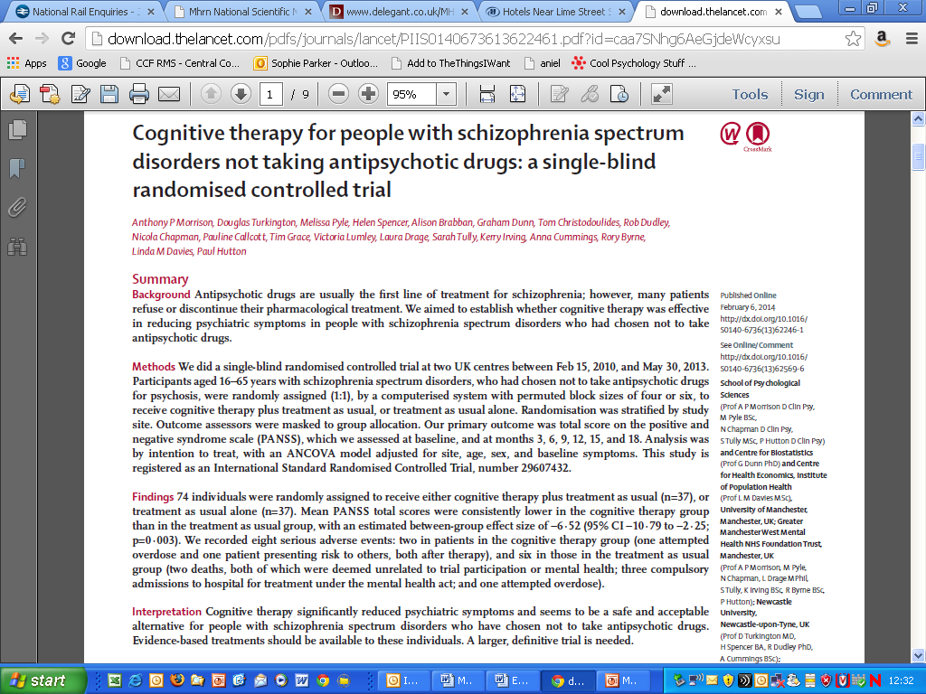
ACTION: Assessing Cognitive Therapy Instead Of Neuroleptics
(formerly North Of Britain Treatment Without Antipsychotics Trial)
Two site single blind RCT with two conditions (CT plus TAU vs. TAU) for people with psychosis not taking antipsychotic medication (due to refusal or discontinuation)
Assessments are 3 monthly following the initial baseline assessment (i.e. at baseline, 3, 6, and 9 months)
Follow-up assessments are at 12, 15 and 18 months
Recruitment target of n=80 – final n = 74

Slide 26
Action trial: therapists and session numbers.
8 therapists contributed to the delivery of CBT within the trial.
The number of participants treated by each therapist ranged between 2 and 18.
participants received a mean of 13.3 sessions (S.D.=7.57; range 2 to 26).
Acceptability: 0 participants not attending any sessions, and 30/37 receiving 6 or more sessions.

Slide 27
Number of sessions to deliver a good outcome and effect size.
Range 5-27 sessions for >50% improvement on PANSS at 9 and 18 month time point.
Mean number of sessions = 19.88
SD = 9.07
The signal here is that a substantial pulse of therapy is needed.
CBT is an acceptable alternative for those who refuse antipsychotics (effect size 0.4).

Slide 28
>50% PANSS Change
At 9 months
7/22 CBT = 32%
3/23 TAU = 13%
At 18 months
7/17 CBT = 41%
3/17 TAU = 18%
NB: 1 deterioration in CBT at 9 and 18 months
2 deteriorations in TAU at 18 months

Slide 29
Traumatic vulnerability within the ACTION study
All patients in the good clinical result CBT group reported high levels of abuse and neglect on the CTQ. Physical neglect/ abuse mean = 16 (group mean = 10) emotional neglect/ abuse mean = 21 (group mean = 14)
The 7 patients who had durable recoveries were all traumatic psychoses according to the definition of sub-types of the schizophrenia spectrum.

Slide 30

5. Is there a biological model for CBT’s action in traumatic psychosis?

Slide 31
Models of CBT action
Symptoms are directly lowered as with an antipsychotic medication.
Symptoms are reduced because CBT improves adherence with medication.
Symptoms are reduced (as in anxiety disorders) by reducing the emotional response (anxiety, depression, shame and anger) to frightening psychotic symptoms and changing behaviour.
Any benefit is entirely non-specific.
Notes:
DT

Slide 32
CBT vs TAU for antipsychotic resistant auditory hallucinations (Aguilar et al, 2017)
41 patients with severe disabling auditory hallucinations randomized to CBT (n=17) TAU (n=24).
Compared with n=14 healthy controls.
CBT group received 16-20 weekly then fortnightly sessions of CBT.
Emotional auditory paradigm used for fMRI investigation at baseline, 9 months and 14 months follow up.

Slide 33
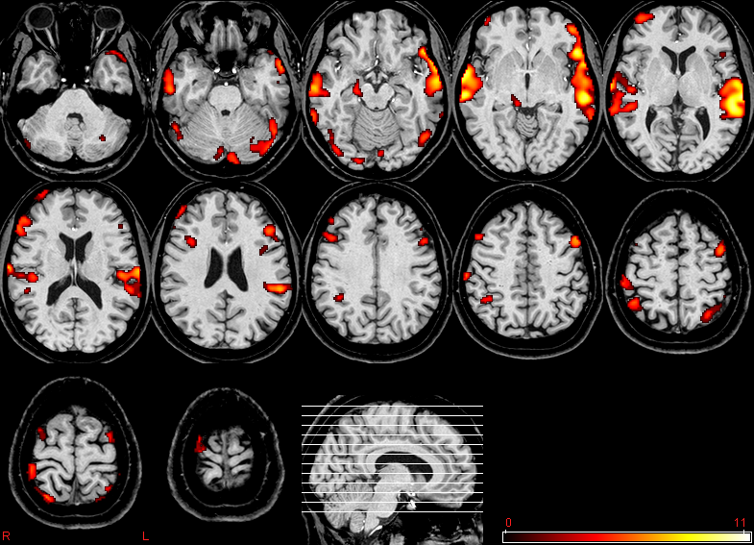
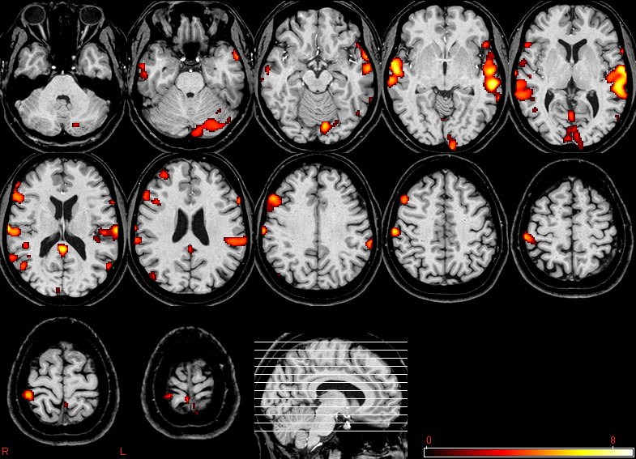
Case 1.
CBT and fMRI (Emotional Paradigm)
    32 YEAR OLD FEMALE WITH SCHIZOPHRENIA AND
    PERSISTENT AUDITORY HALLUCINATIONS (9 months CBT)
1ª RM
2ª RM
31.8 % REDUCTION ACTIVATION

Slide 34
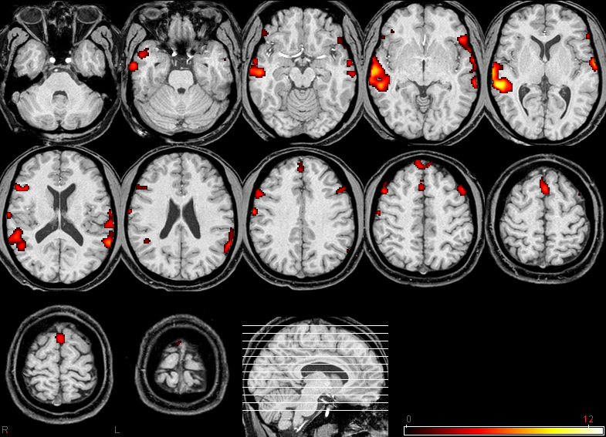
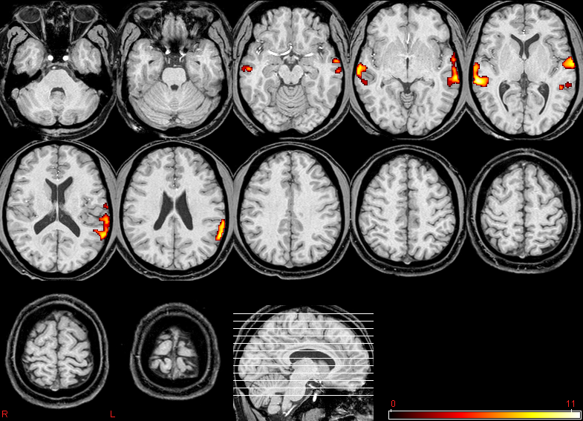
Case 2.
CBT and fMRI (Emotional Paradigm)
    32 years Male with Schizophrenia and Persistent Auditory Hallucinations (6months CBT)
1ª RM
2ª RM
4.81 % Reduction of activation

Slide 35
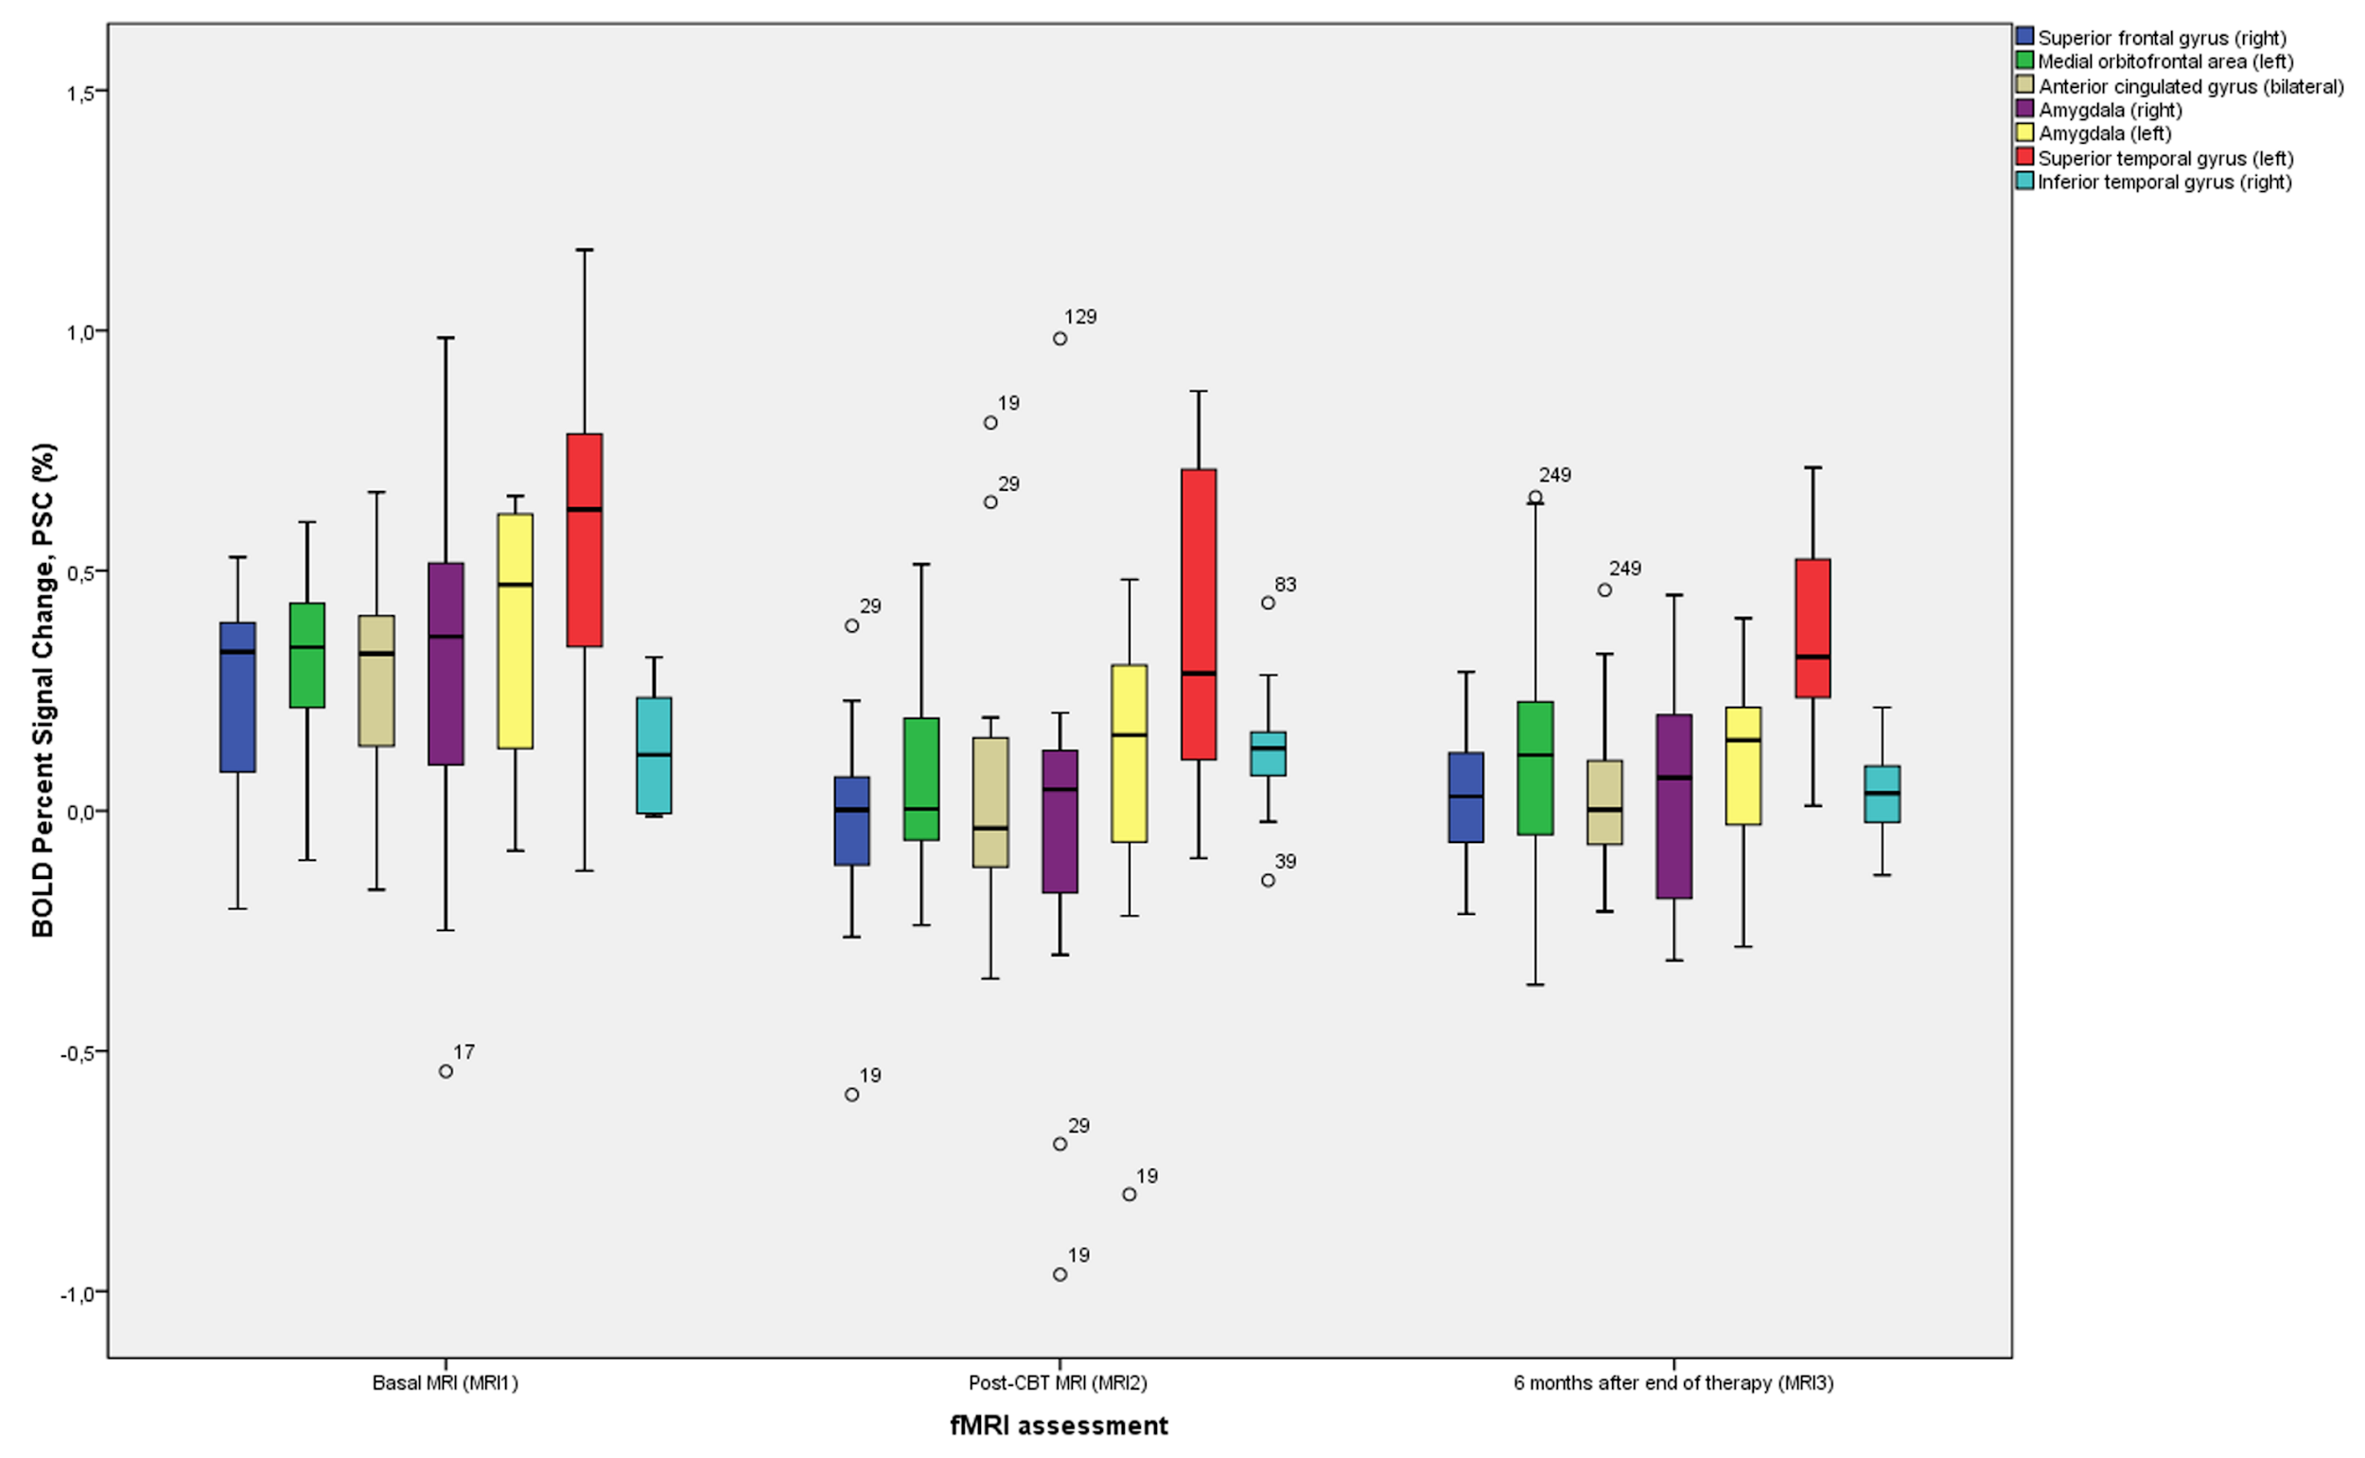
Results

Slide 36
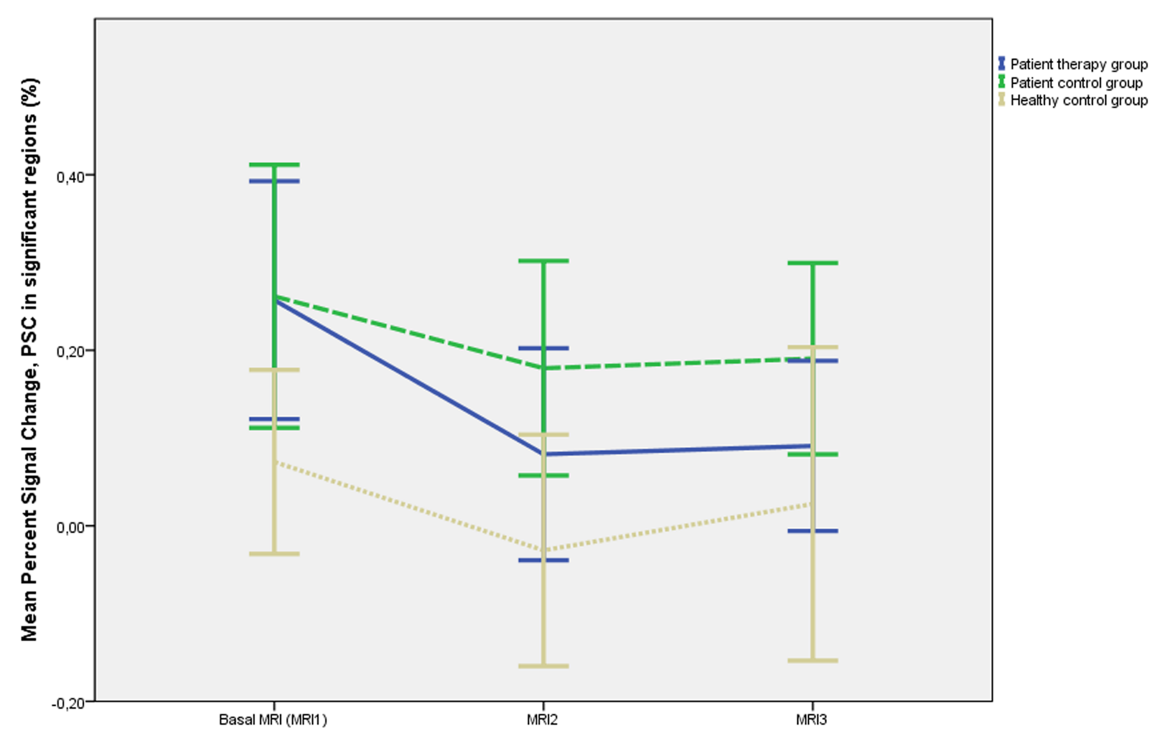

Slide 37
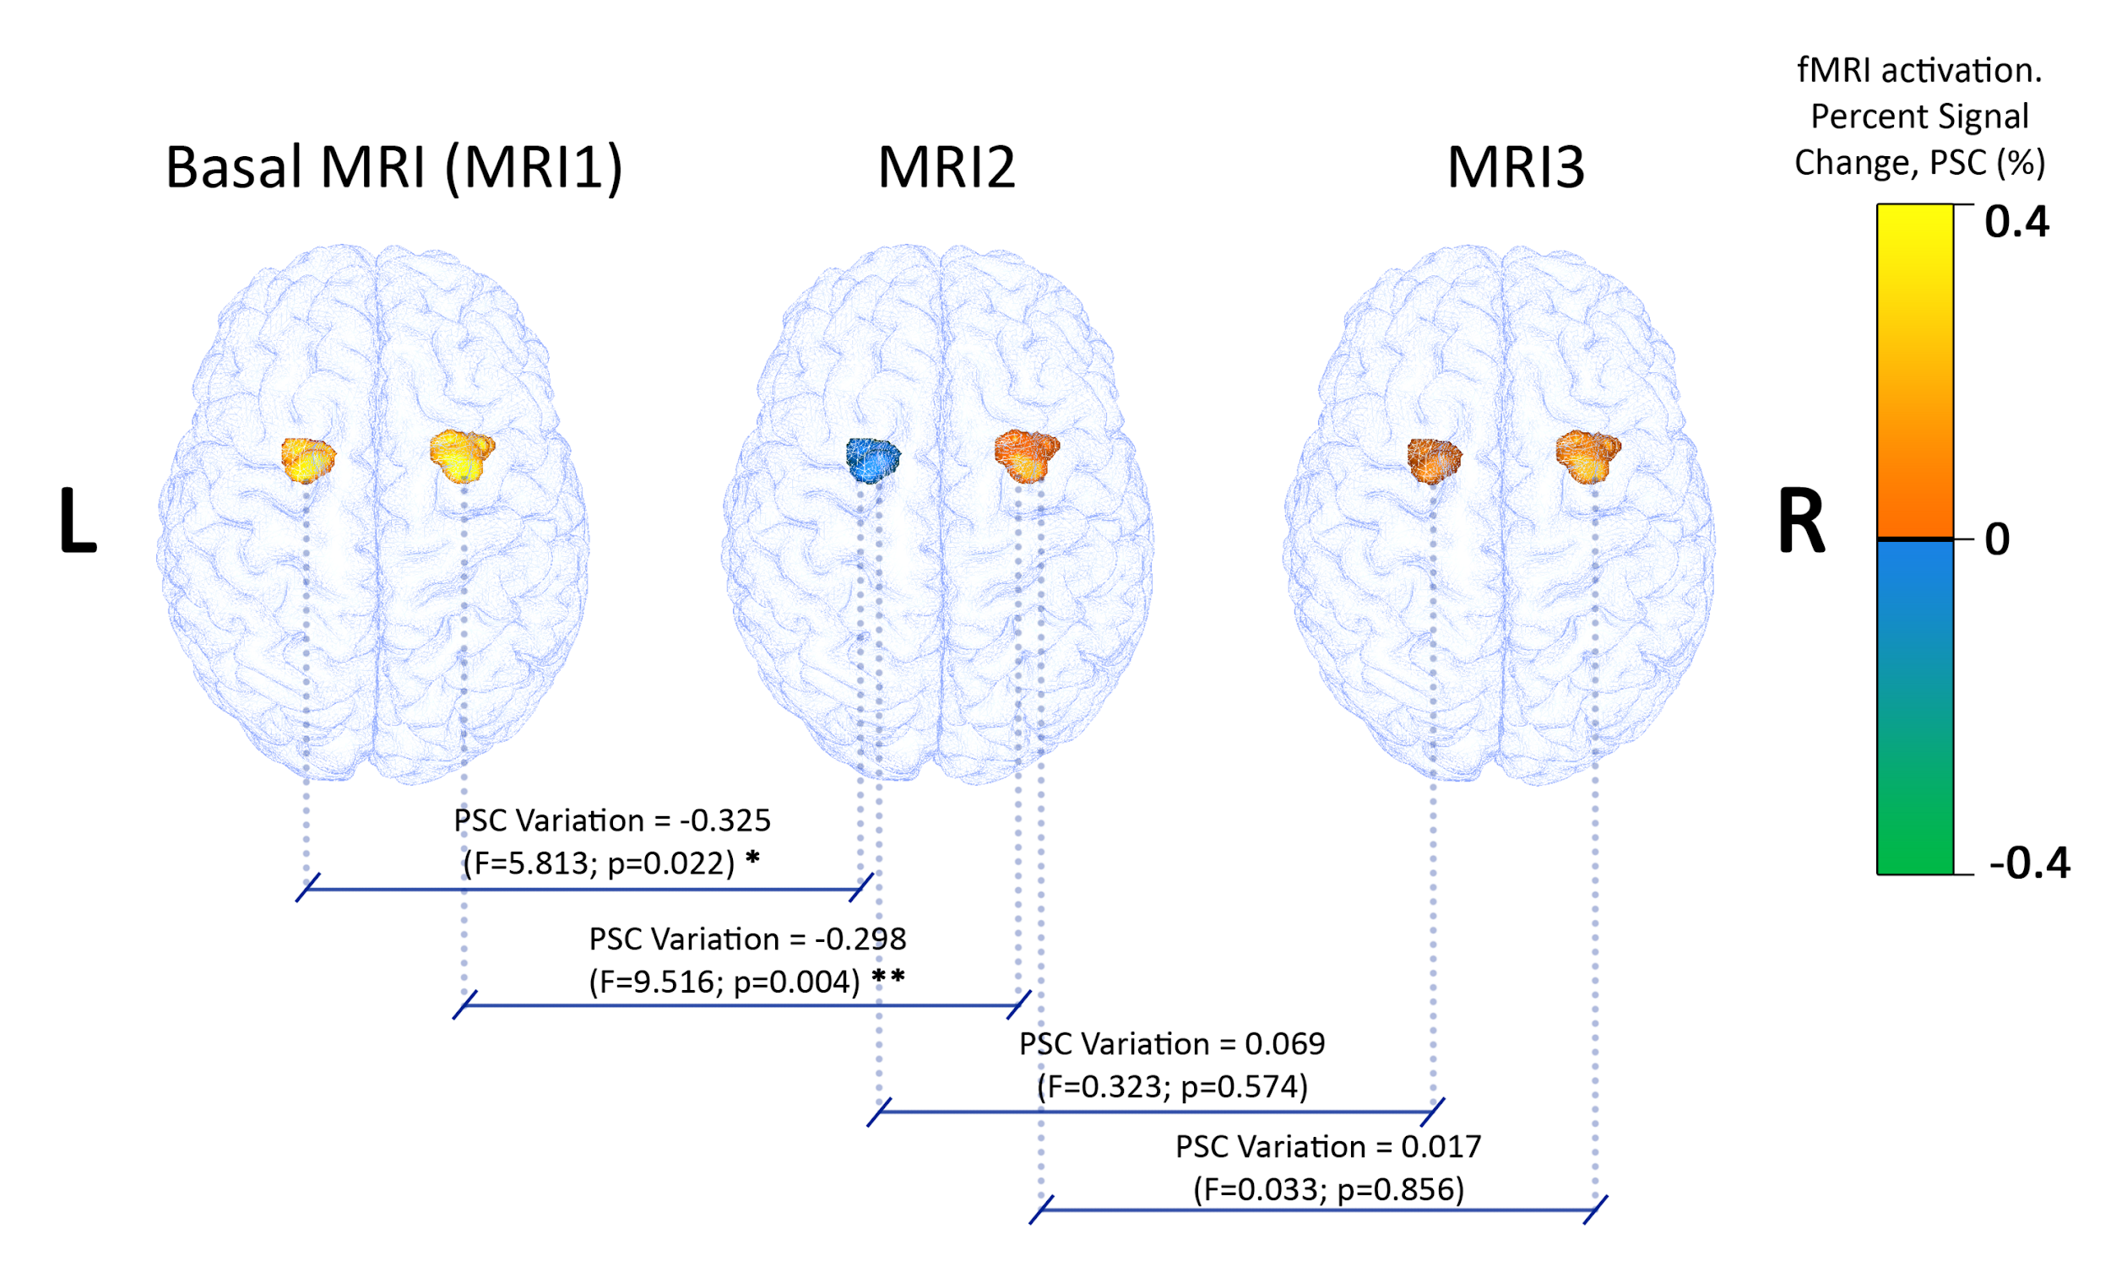

Slide 38
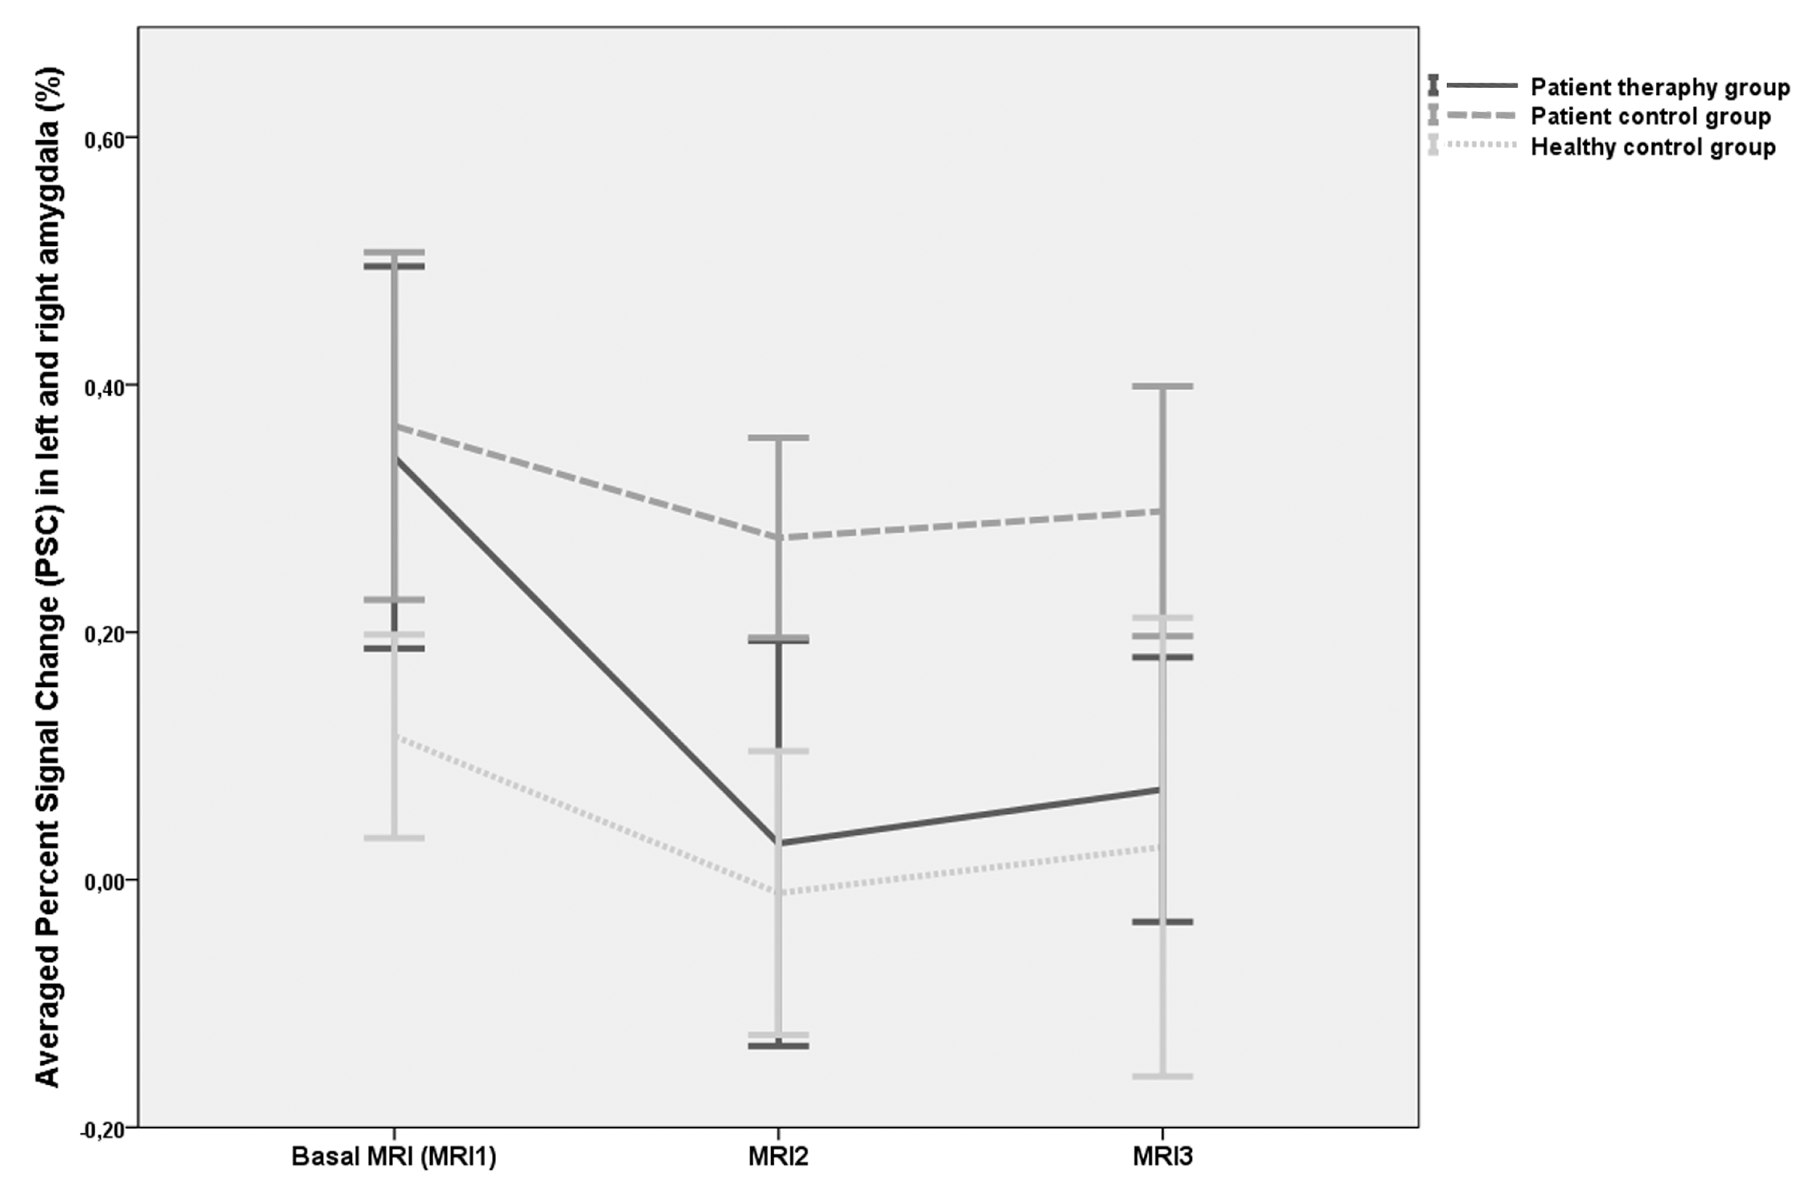

Slide 39
Results
CBT group showed significant reduction in right and left amygdalae and left middle temporal gyrus as compared to both control groups at 9 month follow up.
CBT group showed significant reduction in both amygdalae, left superior temporal gyrus and right superior frontal gyrus at 14 month follow up.
Emotional auditory paradigm as measured by fMRI could indicate a potential imaging biomarker for CBT response.

Slide 40
Mode of action
CBT might be stabilizing and normalizing amydala function by processing of memories linked to traumatic episodes, improving decision making and/or the improving the processing of emotional responses such as anxiety, anger, sadness and shame.
The left middle temporal gyrus has been linked with accessing word meaning.
The left superior temporal gyrus contains the primary auditory cortex which is responsible for processing sounds.
The right superior frontal gyrus is involved in attention control.

Slide 41
Conclusions
The integrated model of CBT reduces the over-activation of the cortex by reducing overactivity in the emotion processing regions of the brain…..voices become less frightening as more is learned about them and they are discussed and worked with in a supportive relationship.
This supports the model that CBT might work as it does in anxiety disorders.
The effect is a logical calming of the brain which is complementary to the benefits of antipsychotic medication.

Slide 42
Presentation questions to be answered
1. Is hallucination a signature symptom of traumatic psychosis? YES (along with delusional interpretation)
2. Can the integrated model (cognitive, metacognitive and compassion focused) be described? YES (cognitive and metacognitive still dominate)
3. Is traumatic psychosis a good outcome group when treated with the integrated approach? YES (and the result is durable)
4. Is there a biological model for CBT’s action in traumatic psychosis?(Aguilar et al, 2017) YES (normalisation of the function of the amygdala).

