Slide 1
Stemmehøring: hva vet vi om dens fenomenologi, spesifisitet og utvikling?
Frank Larøi
Universitet i Bergen
Universitet i Liege

Slide 2
Definition: A false sensory perception that has a compelling sense of reality despite the absence of an external stimulus (APA Dictionary of Psychology)

Slide 3
Definition: A false sensory perception that has a compelling sense of reality despite the absence of an external stimulus (APA Dictionary of Psychology)
David (2004):
over which the subject does not feel s/he has direct and voluntary control
which occurs in the awake state

Slide 4
How are hallucinations conceptualized at present?
Not necessarily as a sign of a mental disorder nor of a pathology
Not necessarily as a strange or bizarre phenomenon but as a phenomenon that we can try to explain
There are a great number of reasons why people experience hallucinations (multidimensional models, multiple pathways, etc.)

Slide 5
The nature of hallucinations, philosophical contributions
Hallucinations are not a perception:
Hallucinations are uni-sensorial; Perceptions are always multi-sensorial
A perception always involves an object

Slide 6
Hallucinations:
Extremely rich
Modalities (auditory, visual, olfactory, gustative, musical, multimodal, etc.)

Slide 7
Hallucinations:
Extremely rich
Modalities (auditory, visual, olfactory, gustative, musical, multimodal, etc.)

Slide 8
Acoustic properties
Linguistic properties
Frequency
Control
Inner-outer localisation
Personification
Appraisals
Content

Slide 9
Acoustic properties
Linguistic properties
Frequency
Control
Inner-outer localisation
Personification
Appraisals
Content

Slide 10
Phenomenology of hallucinations
Variable
Inter-individual variation
Intra-individual variation (e.g. according to clinical state)

Slide 11
Phenomenology of hallucinations
Variable
Inter-individual variation
Intra-individual variation (e.g. according to clinical state)
Jones (2010)
“Dynamic Developmental Progression”
AVHs tend to evolve over time
change in the nature of the AVHs
change in the distress/beliefs associated with AVHs
No good studies here

Slide 12
Phenomenology of hallucinations
Complex

Slide 13
Hallucinations as «voices»
Not always a good metaphor
Moritz & Larøi (2008):
37%: hallucinations are not like real voices

Slide 14
E Kraepelin, Clinical Psychiatry: A textbook for students and physicians (1902)

Slide 15
Phenomenology of hallucinations
Heterogeneity

Slide 16
Jones (2010)
Prima facie heterogeneity of AVHs
« … AVH … may involve single and/or multiple voices, who may be known and/or unknown, speaking sequentially and/or simultaneously, in the first, second, and/or third person and which may give commands, comments, insults, or encouragement »

Slide 17
Several types / subgroups of AVHs?
McCarthy-Jones et al. (2014)
Cluster analysis on 199 patients:
Short that repeat themselves (commands, commentaries)
Obsessional thoughts?
Content identical to words/conversations from the past
Form of « flash-backs » as in PTSD?
Very similar to own thoughts (e.g. in 1st person)

Slide 18
Clinical groups and hallucinations
Clearly a common symptom in schizophrenia (50-80%)

Slide 19
Clinical groups and hallucinations
Clearly a common symptom in schizophrenia (50-80%)
BUT…

Slide 20
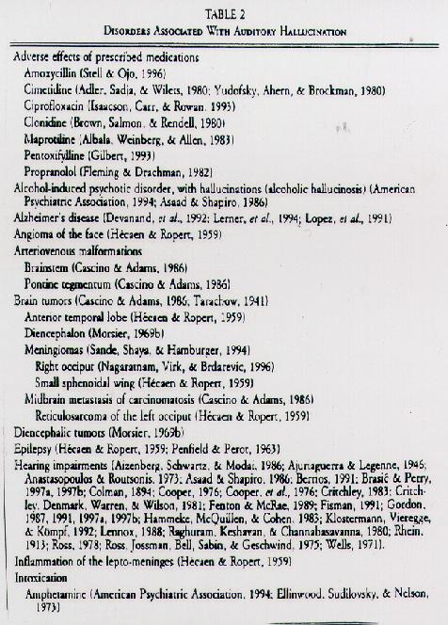
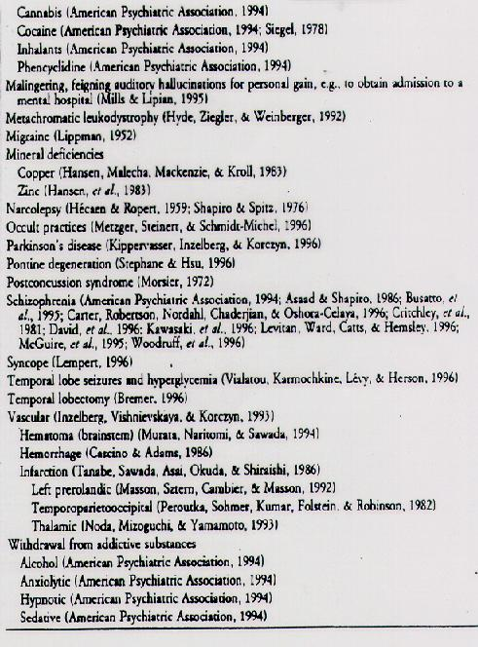

Slide 21
Aleman & Larøi (2008)

Slide 22
Aleman & Larøi (2008)

Slide 23
Aleman & Larøi (2008)

Slide 24
Challenges the idea that hallucinations are necessarily a sign of psychosis

Slide 25
Healthy, “non-clinical” persons may also have this experience
Children, adolescents, adults, elderly

Slide 26
Healthy, “non-clinical” persons may also have this experience
Children, adolescents, adults, elderly

Slide 27
Healthy, “non-clinical” persons may also have this experience
Children, adolescents, adults, elderly
Beavan et al. (2011), review paper
17 studies; N = ±70,000 persons in total
5-15% of the general population hears voices

Slide 28
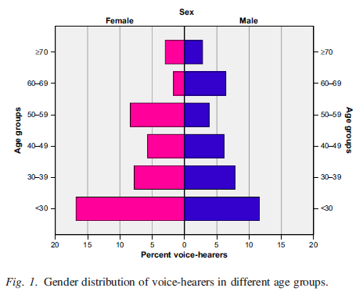
N = 2533; 18 years or older
7.3% life-time prevalence of AVH

Slide 29
Challenges the idea that hallucinations are necessarily a sign of pathology

Slide 30
Continuum hypothesis of hallucinations
No qualitative differences between « clinical » and « nonclinical » hallucinations
But rather mainly quantitative differences
In hallucinations as in other psychopathological experiences/conditions (delusions, dissociation, depression, social phobia, etc.)

Slide 31
Nonclinical Clinical
N
O
R
M
A
L
P
A
T
H
O
Hallucinations

Slide 32
Aleman & Larøi (2008)

Slide 33
Aleman & Larøi (2008)

Slide 34
van Os et al. (2000) :
6.2% : subclinical (no distress or help-seeking behaviour)
1.7% : clinically relevant (associated with distress and help-seeking behaviour)

Slide 35
Healthy, “non-clinical” persons may also have this experience
Children, adolescents, adults, elderly

Slide 36
Children:
McGee et al. (2000): 8% hallucinations prevalence in children

Slide 37
Aleman & Larøi (2008)

Slide 38
Stop spontaneously
Persist but with no impact
Hallucinations
childhood
Persist but with impact (development of psychopathology)

Slide 39
Stop spontaneously: 76% (12-13 y.o.)
5 years
Hallucinations
childhood (7-8 y.o.)
Bartels-Velthuis et al. (2011)

Slide 40
Stop spontaneously: 59-95% (after some weeks/months)
Rubio et al. (2102): Review paper (11 studies)
Hallucinations
childhood

Slide 41
Stop spontaneously: 59-95% (after some weeks/months)
Rubio et al. (2102): Review paper (11 studies)
Jardri et al. (2014): “…most nonpsychotic hallucinations are associated with periods of anxiety and stressful events and disappear when the stressful situation is resolved”
Hallucinations
childhood

Slide 42
Stop spontaneously
Persist but with no impact
Hallucinations
childhood
Mood disorders
Psychotic disorders
Substance disorders
PTSD
Social phobia
Persist but with impact (development of psychopathology)

Slide 43
Stop spontaneously
Persist but with no impact
Hallucinations
childhood
7.4% developed a psychotic disorder
Persist but with impact (development of psychopathology)
Lindscott & van Os (2013)

Slide 44
Healthy, “non-clinical” persons may also have this experience
Children, adolescents, adults, elderly

Slide 45
Aleman & Larøi (2008)

Slide 47
19-30 yrs 31-60 yrs 61-96 yrs

Slide 49
Nonclinical Clinical
N
O
R
M
A
L
P
A
T
H
O
Hallucinations

Slide 50
Schizophrenia with hallucinations
Hallucinations frequently with other disorders
Hallucinations frequently
Hallucinations sometimes/rarely (particular contexts)

Slide 51
Schizophrenia with hallucinations
Hallucinations frequently with other disorders
Hallucinations frequently
Hallucinations sometimes/rarely (particular contexts)
?
?
?

Slide 52
Schizophrenia with hallucinations
Hallucinations frequently with other disorders
Hallucinations frequently
Hallucinations sometimes/rarely (particular contexts)
Person A

Slide 53
Schizophrenia with hallucinations
Hallucinations frequently with other disorders
Hallucinations frequently
Hallucinations sometimes/rarely (particular contexts)
Person B

Slide 54
Possible approaches to better elucidate this process:
Combined epidemiological and longitudinal studies
Nature of the transition from a non-clinical hallucination to a clinical hallucination
Compare AVHs in patients and non-patients (voice-hearers)
Differences: factors and mechanisms involved in developing problematic AVHs, but also “protective” mechanisms and factors that help prevent someone from developing problematic AVHs
Detailed assessment of changes in mental experiences that occur before AVHs develop, especially during early (i.e., prodromal) phases of psychosis

Slide 55
Possible approaches to better elucidate this process:
Combined epidemiological and longitudinal studies
Nature of the transition from a non-clinical hallucination to a clinical hallucination
Compare AVHs in patients and non-patients (voice-hearers)
Differences: factors and mechanisms involved in developing problematic AVHs, but also “protective” mechanisms and factors that help prevent someone from developing problematic AVHs
Detailed assessment of changes in mental experiences that occur before AVHs develop, especially during early (i.e., prodromal) phases of psychosis

Slide 56
Krabbendam et al. (2005): Longitudinal and epidemiological study
4670 participants, followed-up 1 & 3 years after
(1) High hallucination proneness
(2) + Mediating factors
a) negative emotions (anxiety, distress, depressed mood)
b) [tendency to experience delusions]
----------------------------------------------------------
= significantly increases the risk of becoming a “clinical case”

Slide 57
It is not the nature of hallucinations in its itself that determines if a person becomes a « clinical case » but rather how the person reacts emotionally/psychologically to these experiences

Slide 58
Kaymaz & Van Os (2010)

Slide 59
Possible approaches to better elucidate this process:
Combined epidemiological and longitudinal studies
Nature of the transition from a non-clinical hallucination to a clinical hallucination
Compare AVHs in patients and non-patients (voice-hearers)
Differences: factors and mechanisms involved in developing problematic AVHs, but also “protective” mechanisms and factors that help prevent someone from developing problematic AVHs
Detailed assessment of changes in mental experiences that occur before AVHs develop, especially during early (i.e., prodromal) phases of psychosis

Slide 60
Schizophrenia with hallucinations
Hallucinations frequently with other disorders
Hallucinations frequently
Hallucinations sometimes/rarely (particular contexts)

Slide 61
Phenomenology
Schizophrenia with hallucinations
Hallucinations frequently with other disorders
Hallucinations frequently
Hallucinations sometimes/rarely (particular contexts)

Slide 62
Daalman et al. (2011)
Patients with psychosis (n=118) who heard voices
Healthy persons (n=111) who heard voices
In both groups: voices minimum once per month, during 1 year
PSYRATS Auditory Hallucinations Rating Scale + supplementary questions

Slide 63
No sig. differences between groups for:
Perceived location (inside/outside of the head)
Loudness
Number of voices
Personification (attribution to a real and familiar person)

Slide 64
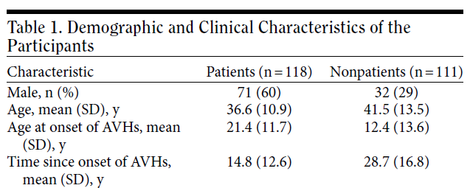

Slide 65
Sig. diffs between groups for:
Negative emotional valence of the content of AVHs
Later age at onset
Higher frequency
Lower degree of control

Slide 66
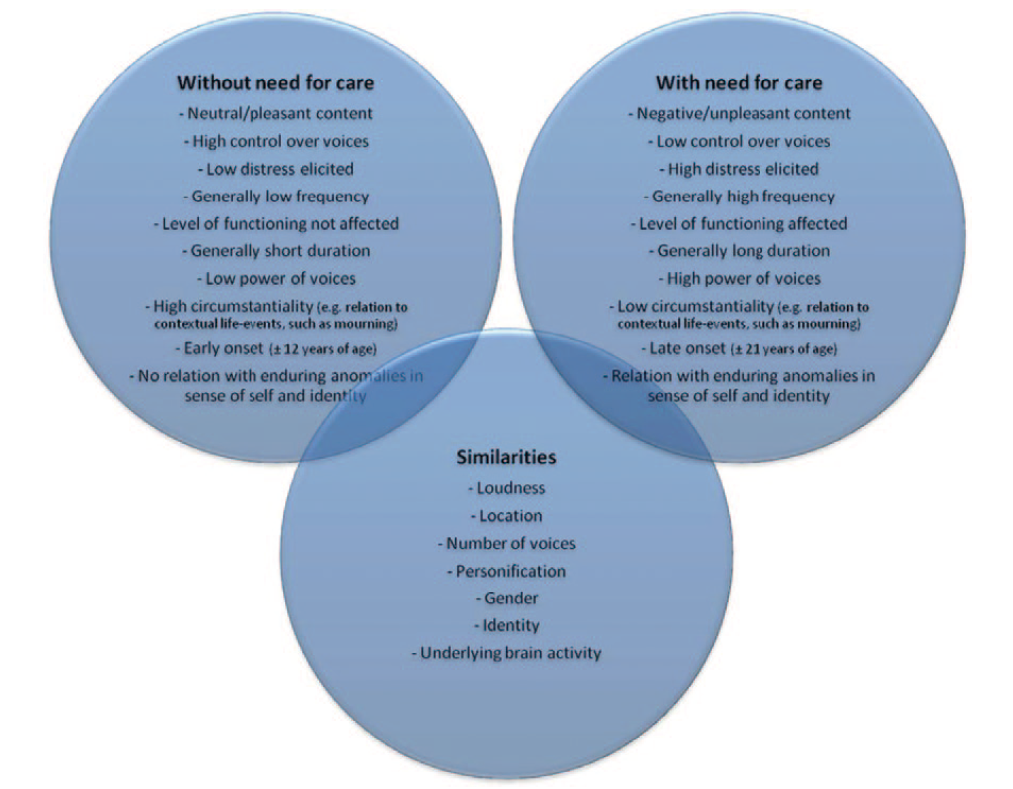
Johns et al. (2014)

Slide 69
Possible approaches to better elucidate this process:
Combined epidemiological and longitudinal studies
Nature of the transition from a non-clinical hallucination to a clinical hallucination
Compare AVHs in patients and non-patients (voice-hearers)
Differences: factors and mechanisms involved in developing problematic AVHs, but also “protective” mechanisms and factors that help prevent someone from developing problematic AVHs
Detailed assessment of changes in mental experiences that occur before AVHs develop, especially during early (i.e., prodromal) phases of psychosis

Slide 70
Clinical staging model for psychosis (Raballo & Larøi, 2009)
Premorbid phase
Prodromal phase I
Prodromal phase II
Psychotic phase
- Anomalous subjective experiences
- Initial psychosocial impairment
- Overt psychotic phase of full-blown prolonged symptoms of psychosis susceptible to develop into schizophrenia
- Detectable vulnerability traits & risk factors
- No gross psychosocial impairment
- Sub threshold, attenuated psychotic symptoms
- And/or brief, limited, intermittent psychosis

Slide 71
Clinical staging model for psychosis (Raballo & Larøi, 2009)
Premorbid phase
Prodromal phase I
Prodromal phase II
Psychotic phase
Clinical AVHs
- Anomalous subjective experiences
- Initial psychosocial impairment
- Overt psychotic phase of full-blown prolonged symptoms of psychosis susceptible to develop into schizophrenia
- Detectable vulnerability traits & risk factors
- No gross psychosocial impairment
- Sub threshold, attenuated psychotic symptoms
- And/or brief, limited, intermittent psychosis

Slide 72
Clinical staging model for psychosis (Raballo & Larøi, 2009)
Premorbid phase
Prodromal phase I
Prodromal phase II
Psychotic phase
Clinical AVHs
- Anomalous subjective experiences
- Initial psychosocial impairment
- Overt psychotic phase of full-blown prolonged symptoms of psychosis susceptible to develop into schizophrenia
- Detectable vulnerability traits & risk factors
- No gross psychosocial impairment
- Sub threshold, attenuated psychotic symptoms
- And/or brief, limited, intermittent psychosis

Slide 73
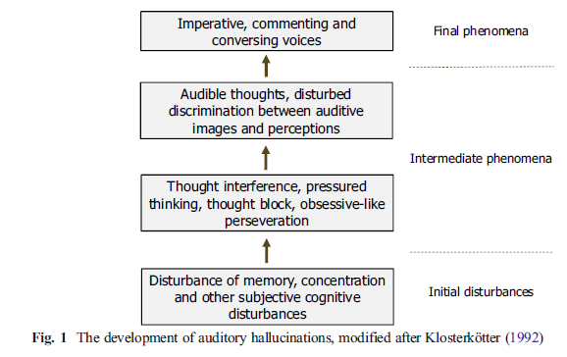
Clinical AVHs

Slide 74
Some examples:
General perceived change in the stream of thoughts of the person
e.g., thoughts no longer shift smoothly and effortlessly from one moment to the next
Thoughts acquire a quasi-sensorial concreteness
e.g., thoughts feel as if endowed with perceptual features/acoustic qualities
Accentuated introspective state of self-monitoring
e.g., where the person attempts to figure out the “specific type of sound” of thoughts

Slide 75
External factors
Adverse life events (ALE)
Culture

Slide 76
External factors
Adverse life events (ALE)
Culture

Slide 77
Meta-analysis (36 studies) : sig. association between psychosis and ALE (in childhood)
If the ALE were removed from the population, number of people with psychosis reduced by 33%
Varese et al. (2012)

Slide 78
Meta-analysis (36 studies) : sig. association between psychosis and ALE (in childhood)
If the ALE were removed from the population, number of people with psychosis reduced by 33%
Varese et al. (2012)

Slide 79
More specifically:
Relation between trauma and auditory-verbal hallucinations in patients with psychosis (Read et al., 2005 ; Longden et al., 2012 ; Sheffield et al., 2013 ; Bentall et al., 2012)

Slide 80
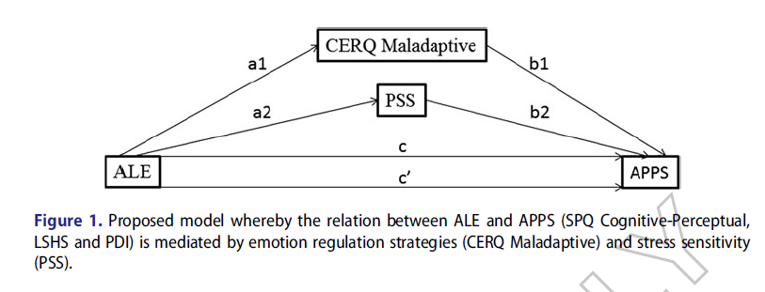

Slide 81
Hallucinations

Slide 83
What situation where you in the first time you heard voices?

Slide 84
Marital problems
Left home
Depression
Divorce
Broken heart
Relational problems
Bullying
Unemployed
Accident
Violence
War
Alcohol/drugs
Death and grief
What situation where you in the first time you heard voices?

Slide 85
participants who had their first
AVH experience in a particular context or situation (possible options to
select were: “marital problems”, “left home”, “depression”, “divorce”,
“broken heart”, “relational problems”, “bullying”, “unemployed”, “accident”,
“violence”, “war”, “alcohol/drugs use”, “death and grief”,
“other”) and those who

Slide 86
More emotional AVHs
More often experienced hall in other (non-auditory) modalities
Poorer general mental health
participants who had their first
AVH experience in a particular context or situation (possible options to
select were: “marital problems”, “left home”, “depression”, “divorce”,
“broken heart”, “relational problems”, “bullying”, “unemployed”, “accident”,
“violence”, “war”, “alcohol/drugs use”, “death and grief”,
“other”) and those who

Slide 87
External factors
Adverse life events (ALE)
Culture

Slide 88
How do communities interpret, legitimize, support, and even produce different voice-hearing experiences?
Culture shapes hallucinations in many dimensions of the phenomena:
acceptability, prevalence, content, etc.
much more research is needed

Slide 89
How do communities interpret, legitimize, support, and even produce different voice-hearing experiences?
Culture shapes hallucinations in many dimensions of the phenomena:
acceptability, prevalence, content, etc.
much more research is needed

Slide 92
General ‘finding’:
AH > VH in Western societies
VH > AH in non-Western societies

Slide 93
General ‘finding’:
AH > VH in Western societies
VH > AH in non-Western societies

Slide 94
High AH and High VH
AH most prevalent in all countries

Slide 95
Bauer et al. (2011)

Slide 97
Nuevo et al. (2012):
Prevalence of psychotic symptoms in the general population
delusional mood, delusions of reference and persecution, delusions of control, hallucinations
52 countries (N=256.445)
Prevalence of having at least 1 psychotic symptom: 12.5%
Hallucinations: 5.8% (all types of hallucinations)
0.8% (Vietnam) – 31.4% (Nepal)

Slide 98
Nuevo et al. (2012):
Prevalence of psychotic symptoms in the general population
delusional mood, delusions of reference and persecution, delusions of control, hallucinations
52 countries (N=256.445)
Prevalence of having at least 1 psychotic symptom: 12.5%
Hallucinations: 5.8% (all types of hallucinations)
0.8% (Vietnam) – 31.4% (Nepal)

Slide 99
Nepal (32.03)
Brazil (13.67)
India (12.29)
Dominican Republic (11.82)
Kenya (11.01)
Swaziland (10.18)
Chad (8.28)
South Africa (8.19)
Burkina Faso (7.37)
Cote d’Ivoire (7.72)
….
China (0.88)
Slovenia (0.87)
Ukraine (0.86)
Sri Lanka (0.72)
Georgia (0.63)
Czech Republic (0.58)
Spain (0.51)
Bosnia and Herzegovina (0.49)
Kazakhstan (0.48)
Vietnam (0.21)
Top 10
Bottom 10

Slide 100
Interdisciplinary

Slide 101
Woods et al. (2014), potential benefits:
Refine AVH subtypes, inform empirical work, enhance therapeutic practice
3 domains:
Cultural, social, historical
Experiential
Narrative/biographical

Slide 102
Levels of Explanation
Cultural/Social
Norms, beliefs, attitudes
Clinical
Symptoms/Syndromes/Diagnoses
Cognitive
Perception, Attention, Executive, Language
Brain imaging
Neuronal systems and networks
Cellular
Synapses and neurotransmitters
Molecular
Genes, DNA, proteins
Levels of Explanation
Hugdahl, 2015

Slide 103
Takk!

