Slide 1

Treatment of Dissociative Disorders: The TOP DD Study Challenges
Myths and Suggests
Future Clinical Directions
Bethany Brand, Ph.D.
Towson University

Slide 2
Complex Dissociative Disorders
Complex clinical presentation complicates diagnosis, research, and treatment
  High Acuity
    frequent suicidal thoughts and/or attempts
    self-injurious behavior
  High and varied co-morbidity
    PTSD, & mood, anxiety, substance use, somatform, personality disorders, and more

Slide 3
Research Studies on Treatment, 1925-2017
Source: PsycInfo & Medline

Slide 4
What We Know Today about
Treatment of Dissociative Disorders

Slide 5
Treatment Should be Phasic
(ISSTD Expert Treatment Guidelines)
Goals: improve affect regulation, management of symptoms, stabilization of safety, improved self-understanding & compassion; increased awareness and cooperation among dissociated self-states
  Long and difficult process
3 stages
  Diagnose and stabilize patient
  Processing & grieving traumas
  Integration: more current day focused; may integrate self-states into one personality

Slide 6
First Stage of Treatment for Complex PTSD
Traumatic material and affect are contained rather than “opened up”
Clients taught techniques to help manage strong feelings and impulses
Clients taught techniques to manage symptoms of PTSD
Therapeutic alliance built
Psychotropic medications tried and adjusted

Slide 7
TOP DD Studies:
Providing Crucial Information about the Treatment of Individuals with
Dissociative Disorders

Slide 8

TOP DD Network Study Researchers
Bethany Brand, Ph.D., Principal Investigator, Towson, Maryland, USA
Hugo Schielke, Ph.D., Co-Investigator, San Francisco, CA, USA
Scientific Consultants:
Frank Putnam, M.D., Chapel Hill, North Carolina, USA
Ruth Lanius, Ph.D., M.D. and Paul Frewen, Ph.D., London, Ontario, Canada
Richard Loewenstein, M.D., and Amie Myrick L.C.P.C., Baltimore, Maryland, USA
Ellen Jepsen, M.D., Ph.D., Modum Bad, Norway
Willemien Langeland, Bascous, France
Kathy Steele, M.N, C.S., Atlanta, Georgia, USA
Suzette Boon, Ph.D., The Netherlands
Clare Pain, M.D., Toronto, Ontario, Canada
Catherine Classen, Ph.D., San Francisco, USA

Slide 9
We are indebted to the following for funding:
Anne Bartoletto and family
Michael Hemmer
Brad Foote, M.D.
ANS Research
Anonymous donation to Sheppard Pratt Health System's Trauma Disorders Research Program
Constantinidas Family Foundation
Trauma Disorders Fund, Sheppard Pratt Health System
Towson University FDRC grant and College of Liberal Arts Grants
Many additional generous donors

Slide 10
Phasic Trauma Treatment That Focuses on Dissociation Does Not Make Patients Worse
Brand, B.L. & Loewenstein, R.J. (2014). Does phasic trauma treatment make patients with dissociative identity disorder treatment more dissociative? Journal of Trauma & Dissociation, 15, 52-65.

Slide 11
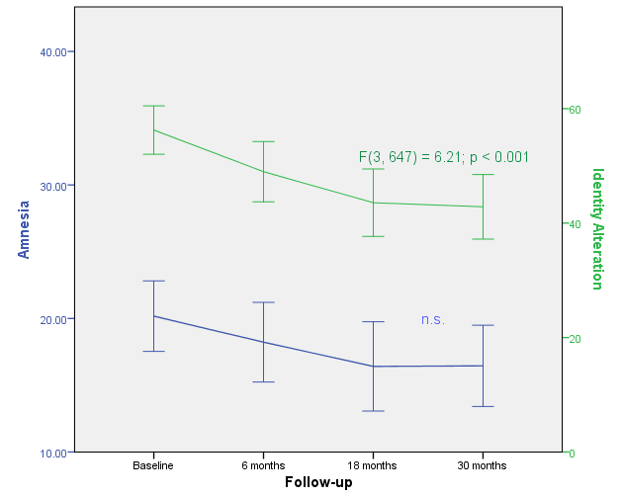
Amnesia and Identity Alternation Over Time in TOP DD Participants

Slide 14
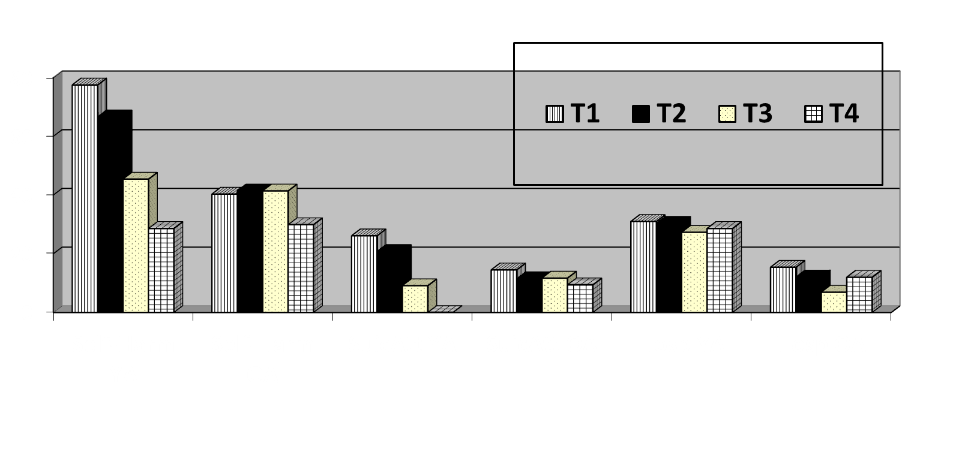
Myrick, Brand, et al. Journal of Trauma and Dissociation.

Slide 15
First TOP DD Methodology: Naturalistic Study
Pilot study assessing DD patients at intake into study, and prospectively at 6, 18, 30 months
280 patients already diagnosed with a DD and in outpatient treatment with community therapists
292 outpatient therapists recruited from professional organizations; therapists recruited 1 patient each

Slide 16
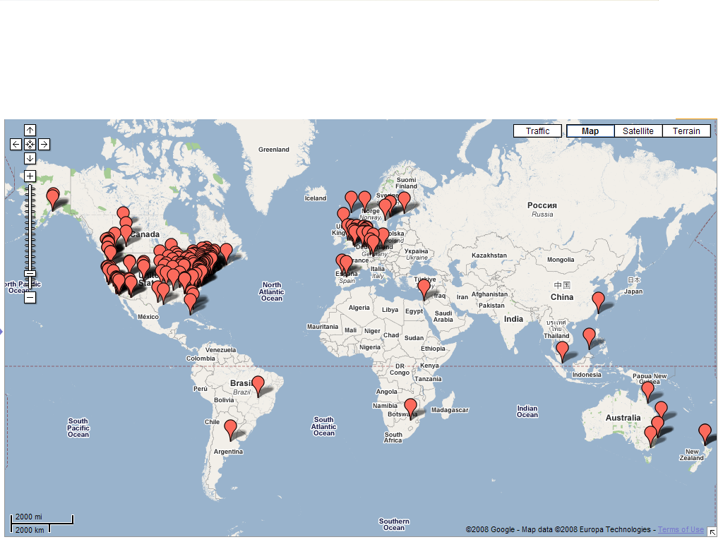
TOPDD Participants

Slide 17
Therapist Reported Baseline Patient Functioning
 | M (SD) | Md | Range | 0 | 1 - 3 | 4 or more
Suicide attempts last year | .47 (1.77) | 0 | 0 - 20 | 84% | 14% | 3%
Hospitalizations past 6 months | 0.5 (1.1) | 0 | 0 - 8 | 75% | 23% | 2%

Slide 18

TOP DD Results
  Fewer suicide attempts and self-harm
  Fewer hospitalizations
  Decreased treatment costs
  Decreased symptoms: depression, PTSD, dissociation, physical pain, general distress, street drug use
  Increased engagement in school, volunteer jobs, & relationships; feeling good

Slide 19
TOP DD Network Methodology and
Overarching Results

Slide 20
TOP DD Network study
Web-based program:
  Free and easily accessible
  Helps educate dissociative people AND therapists:
    Improving affect regulation
    Improving control over dissociation
    Improving safety
45 videos plus weekly written reflection and practice exercises
2 years access to educational program

Slide 21
TOP DD Network study
Adjunctive educational program
  Patients AND their therapists had to both agree to participate
Patients already being treated for DD
No patient excluded based on severity of safety problems, co-morbid disorders, medications
No control group

Slide 22
TOP DD Network study
Example:
  Video: reasons traumatized people hurt themselves
  Written: make a list of reasons why you self-harm; make a safe coping list (healthy alternatives)
  Practice: use safe coping list this week

Slide 24
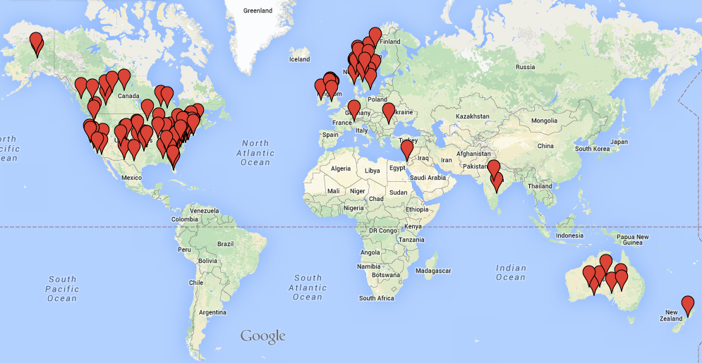
TOP DD Network Participants

Slide 25
Methodology
N = 111 patients with data for intake and
1 &/or 2 year assessments
Examined overall sample and high dissociation (DES scores of 30 or more; n = 71) versus low dissociation (DES scores less than 30; n = 40) subsamples
Notes:
1. including general quality of life and personality, romantic relationship, friendship, vocational, and physical health.
Are they not at all, moderately, or extremely lacking in quality of life?
2. Do these symptoms have any impact on their quality of life?
3. Given our findings…

Slide 26
Methodology
Analyses:
  1. Cohen’s effect sizes using paired data to examine change in outcomes
  2. Mixed REML method of testing models using linear within-subject effects over time and between-subject effects for high and low DES groups.
      Covariates included when significant. SAS 9.3mixed procedure accommodates missing data.
      Bonferroni post hoc comparisons for interactions and main effects.
Notes:
1. including general quality of life and personality, romantic relationship, friendship, vocational, and physical health.
Are they not at all, moderately, or extremely lacking in quality of life?
2. Do these symptoms have any impact on their quality of life?
3. Given our findings…

Slide 27
Patient and Therapist Report Measures
PTSD Checklist-Civilian Form (PCL-C)
Dissociative Experiences Scale (DES)
Difficulties in Emotion Regulation Scale (DERS)
Progress in Treatment Questionnaire – Patient Version (PITQ-p)
Progress in Treatment Questionnaire – Therapist Version (PITQ-t) (therapist measure)
World Health Organization Quality of Life-BREF (WHOQOL-BREF)

Slide 28
Paired Sample Statistics: PTSD & Dissociation
Variable | Time | Mean | Std. Deviation | Std. Error Mean
PCL-C | Initial | 60.30 | 10.58 | 1.09
 | 18 mos | 55.51 | 12.60 | 1.30
DES | Initial | 38.61 | 19.60 | 2.02
 | 18 mos | 31.02 | 19.17 | 1.98
DES-Taxon | Initial | 36.48 | 21.28 | 2.19
 | 18 mos | 30.21 | 21.24 | 2.19
Notes:
(pathological dissociation probability)

Slide 29
Dependent Samples t-Tests: PCL-C, DES
Variable | t | df | Significance (2-tailed, 95% C.I.) | Mean Difference | Std. Error Mean | Signif. Difference?
PCL-C | 4.42 | 93 | .000 | 4.79 | 1.08 | YES, p<.001
DES | 5.3 | 93 | .000 | 7.59 | 1.43 | YES, p<.001
DES-Taxon | 3.99 | 93 | .000 | 6.26 | 1.57 | YES, p<.001

Slide 30
Paired Sample Statistics: Emotion Regulation (DERS)
Variable | Time | Mean | Std. Deviation | Std. Error Mean
Total score | Initial | 117.36 | 20.54 | 2.12
 | 18 mos | 102.69 | 24.17 | 2.49
Nonacceptance of Emotional Responses | Initial | 20.56 | 6.14 | .63
 | 18 mos | 17.56 | 6.40 | .66
Difficulties in Goal-Directed Behavior | Initial | 17.61 | 4.38 | .45
 | 18 mos | 16.12 | 4.44 | .46
Impulse Control Difficulties | Initial | 15.12 | 4.84 | .50
 | 18 mos | 13.24 | 4.61 | .48
Lack of Emotional Awareness | Initial | 21.90 | 4.20 | .43
 | 18 mos | 19.43 | 4.97 | .51
Limited self-regulation strategies | Initial | 25.18 | 5.81 | .60
 | 18 mos | 21.76 | 6.27 | .65
Lack of emotional clarity | Initial | 16.99 | 3.66 | .38
 | 18 mos | 14.59 | 3.97 | .41

Slide 31
Dependent Samples t-Tests: DERS
Variable | t | df | Significance (2-tailed, 95% C.I.) | Mean Difference | Std. Error Mean | Signif. Difference?
Difficulties in Emotional Regulation Total score | 6.99 | 93 | .000 | 14.67 | 2.10 | YES, p<.001
Nonacceptance of Emotions | 4.76 | 93 | .000 | 3.00 | .63 | YES, p<.001
Difficulties in Goal-Directed Behavior | 3.28 | 93 | .001 | 1.49 | .45 | YES, p=.001
Impulse Control Difficulties | 4.53 | 93 | .000 | 1.87 | .41 | YES, p<.001
Lack of Emotional Awareness | 6.34 | 93 | .000 | 2.48 | .39 | YES, p<.001
Limited self-regulation strategies | 5.80 | 93 | .000 | 3.43 | .59 | YES, p<.001
Lack of emotional clarity | 6.22 | 93 | .000 | 2.40 | .39 | YES, p<.001

Slide 32
Progress in Treatment Questionnaire (PITQ-t)
  New measure based on capacities described in ISSTD’s Treatment Guidelines
  Therapists’ assessment of patient’s current ability to:
    tolerate affect, body sensations, and impulses without dissociating or being unsafe
    maintain therapeutic alliance
    become aware of dissociated self states and their functions
    process traumatic memories with affect
    experience co-consciousness
    integrate self states
    maintain healthy relationships
    experience sense of meaning in life

Slide 33
Methodology
Progress in Treatment Questionnaire (PITQ-t)
    Example:
Knows and uses grounding techniques to prevent self from going numb, zoning out, having amnestic lapses when needed (e.g., techniques such as muscle contractions, movement, or touching an object to avoid dissociating).
0% 10 20 30 40 50 60 70 80 90 100%
(never/NA) (always)

Slide 34
Paired Sample Statistics: PITQ-t, PITQ-p
Variable | Time | Mean | Std. Deviation | Std. Error Mean
Progress in Treatment Questionnaire – Therapist (PITQ-t) | Initial | 48.35 | 13.34 | 1.49
 | 18 mos | 55.08 | 14.29 | 1.60
Progress in Treatment Questionnaire – Patient (PITQ-p) | Initial | 45.57 | 14.54 | 1.50
 | 18 mos | 54.47 | 16.66 | 1.72

Slide 35
Dependent Samples t-Tests: PITQ-t, PITQ-p
Variable | t | df | Significance (2-tailed, 95% C.I.) | Mean Difference | Std. Error Mean | Signif. Difference?
Progress in Treatment Questionnaire – Therapist (PITQ-t) | -6.74 | 79 | .000 | -6.73 | 1.00 | YES, p<.001
Progress in Treatment Questionnaire – Patient (PITQ-p) | -5.88 | 93 | .000 | -8.90 | 1.51 | YES, p<.001

Slide 36
PITQ-p items (7 days): Paired Sample Statistics
Variable | Sample | N | Mean | Std. Deviation | Std. Error Mean
Self-compassion | Initial | 94 | 24.47 | 22.41 | 2.31
 | 18 mos | 94 | 43.83 | 26.07 | 2.69
Aware of thoughts, feelings, sensations that indicate anxiety, overwhelm | Initial | 94 | 47.02 | 24.62 | 2.53
 | 18 mos | 94 | 55.74 | 23.35 | 2.41
Use healthy coping when anxious or at risk of overwhelm | Initial | 94 | 41.17 | 28.81 | 2.97
 | 18 mos | 94 | 53.09 | 28.29 | 2.92
Use containment skills for PTSD symptoms | Initial | 94 | 27.23 | 25.92 | 2.67
 | 18 mos | 94 | 40.96 | 26.32 | 2.72
I use grounding strategies when needed | Initial | 94 | 41.28 | 27.13 | 2.80
 | 18 mos | 94 | 57.98 | 25.47 | 2.63
Notes:
I am compassionate and fair with myself, that is, I respond to myself with as much empathy as I would show someone else in the same situation
I'm aware of the thoughts, feelings, and body sensations that indicate I’m getting anxious or overwhelmed
I use relaxation techniques (such as relaxation exercises, safe place imagery, music) to safely help myself relax and feel better when I begin to get anxious or overwhelmed - I use relaxation techniques (such as relaxation exercises, safe place imagery, music) to safely help myself relax and feel better when I begin to get anxious or overwhelmed
I manage intrusive memories and flashbacks using containment strategies (imagery techniques used to contain and manage PTSD symptoms)

Slide 37
PITQ-p items (7 days): Dependent Samples t-tests
Variable | t | df | Signific. (2-tailed 95% C.I.) | Mean Difference | Std. Error Mean | Signif. Different?
Self-compassion | -7.56 | 93 | .000 | -19.36 | 2.56 | YES, p<.001
Aware of thoughts, feelings, sensations that indicate anxiety, overwhelm | -2.92 | 93 | .004 | -8.72 | 2.99 | YES, p<.005
Use healthy coping when anxious or at risk of overwhelm | -4.12 | 93 | .000 | -11.91 | 2.89 | YES, p<.001
Use containment skills for PTSD symptoms | -4.52 | 93 | .000 | -13.72 | 3.04 | YES, p<.001
I use grounding strategies when needed | -5.20 | 93 | .000 | -16.70 | 3.20 | YES, p<.001
Notes:
I am compassionate and fair with myself, that is, I respond to myself with as much empathy as I would show someone else in the same situation
I'm aware of the thoughts, feelings, and body sensations that indicate I’m getting anxious or overwhelmed
I use relaxation techniques (such as relaxation exercises, safe place imagery, music) to safely help myself relax and feel better when I begin to get anxious or overwhelmed - I use relaxation techniques (such as relaxation exercises, safe place imagery, music) to safely help myself relax and feel better when I begin to get anxious or overwhelmed
I manage intrusive memories and flashbacks using containment strategies (imagery techniques used to contain and manage PTSD symptoms)

Slide 38
PITQ-p items (7 days): Paired Sample Statistics
Variable | Sample | N | Mean | Std. Deviation | Std. Error Mean
If I begin to confuse the past with the present, I notice this and work to see differences | Initial | 94 | 36.28 | 26.31 | 2.71
 | 18 mos | 94 | 54.79 | 26.35 | 2.72
I am aware of my emotions and body sensations | Initial | 94 | 40.53 | 23.34 | 2.41
 | 18 mos | 94 | 51.06 | 23.16 | 2.39
I am able to feel my emotions without getting overwhelmed | Initial | 94 | 33.19 | 22.78 | 2.35
 | 18 mos | 94 | 48.09 | 22.87 | 2.36
I am aware of, able to think about, and can control my impulses | Initial | 94 | 55.21 | 28.27 | 2.92
 | 18 mos | 94 | 63.72 | 26.47 | 2.73
I know that the traumas that I experienced were not my fault | Initial | 94 | 45.74 | 30.64 | 3.16
 | 18 mos | 94 | 56.60 | 31.51 | 3.25
Notes:
I use grounding techniques when I need to prevent myself from going numb, zoning out, or losing time (Examples: focus on my surroundings pay attention to my five senses tense and relax my muscles )
If I begin to confuse the past with the present, I notice this and work to see differences between how things are now versus how they were when I was being traumatized
I am aware of, able to think about, and can control my impulses (Example: I can feel angry or depressed without doing something unhealthy )

Slide 39
PITQ-p items (7 days): Dependent Samples t-tests
Variable | t | df | Signific. (2-tailed 95% C.I.) | Mean Difference | Std. Error Difference | Signif. Different?
If I begin to confuse the past with the present, I notice this and work to see differences | -5.45 | 93 | .000 | -18.51 | 3.40 | YES, p<.001
I am aware of my emotions and body sensations | -3.87 | 93 | .000 | -10.53 | 2.72 | YES, p=.001
I am able to feel my emotions without getting overwhelmed | -5.71 | 93 | .000 | -14.89 | 2.61 | YES, p<.001
I am aware of, able to think about, and can control my impulses | -2.54 | 93 | .013 | -8.51 | 3.36 | YES, p=.01
I know that the traumas that I experienced were not my fault | -3.35 | 93 | .001 | -10.85 | 3.24 | YES, p=.001
Notes:
I use grounding techniques when I need to prevent myself from going numb, zoning out, or losing time (Examples: focus on my surroundings pay attention to my five senses tense and relax my muscles )
If I begin to confuse the past with the present, I notice this and work to see differences between how things are now versus how they were when I was being traumatized
I am aware of, able to think about, and can control my impulses (Example: I can feel angry or depressed without doing something unhealthy )

Slide 40
PITQ-p items (7 days): Paired Sample Statistics
Variable | Sample | N | Mean | Std. Deviation | Std. Error Mean
I manage everyday life well (I regularly eat, bathe, pay bills on time, etc.) | Initial | 94 | 63.19 | 26.89 | 2.78
 | 18 mos | 94 | 68.94 | 24.12 | 2.49
I am able to account for all that I do (I don’t lose time or find evidence of having done something I don’t remember) | Initial | 94 | 48.19 | 31.00 | 3.20
 | 18 mos | 94 | 55.21 | 29.58 | 3.05
I am able to deal with stressful situations without dissociating | Initial | 94 | 39.47 | 25.96 | 2.68
 | 18 mos | 94 | 50.43 | 25.52 | 2.63
I value my physical well-being, and do not do things that hurt my body (Examples: I don’t cut or burn my body or attempt suicide ) | Initial | 94 | 60.85 | 33.72 | 3.48
 | 18 mos | 94 | 69.15 | 26.83 | 2.77

Slide 41
PITQ-p items (7 days): Dependent Samples t-tests
Variable | t | df | Signific. (2-tailed 95% C.I.) | Mean Difference | Std. Error Difference | Signif. Different?
I manage everyday life well (I regularly eat, bathe, pay bills on time, etc.) | -2.35 | 93 | .021 | -5.74 | 2.44 | YES, p<.05
I am able to account for all that I do (I don’t lose time or find evidence of having done something I don’t remember) | -2.17 | 93 | .032 | -7.02 | 3.23 | YES, p<.05
I am able to deal with stressful situations without dissociating | -3.83 | 93 | .000 | -10.96 | 2.86 | YES, p<.001
I value my physical well-being, and do not do things that hurt my body (Examples: I don’t cut or burn my body or attempt suicide ) | -2.59 | 93 | .011 | -8.30 | 3.20 | YES, p=.01

Slide 42
PITQ-p items (7 days): Paired Sample Statistics
Variable | Sample | N | Mean | Std. Deviation | Std. Error Mean
I am able to experience sadness and grieve losses related to trauma | Initial | 94 | 30.64 | 24.71 | 2.55
 | 18 mos | 94 | 45.11 | 27.93 | 2.88
Life feels meaningful and rewarding | Initial | 94 | 30.96 | 22.63 | 2.33
 | 18 mos | 94 | 41.70 | 25.93 | 2.67
I have a generally positive view of myself | Initial | 94 | 30.00 | 24.50 | 2.53
 | 18 mos | 94 | 39.79 | 25.57 | 2.64
I can explore the meaning and impact related to the traumas I experienced I can feel and express the emotions related to these traumas | Initial | 94 | 30.96 | 24.59 | 2.54
 | 18 mos | 94 | 42.98 | 25.69 | 2.65

Slide 43
PITQ-p items (7 days): Dependent Samples t-tests
Variable | t | df | Signific. (2-tailed 95% C.I.) | Mean Difference | Std. Error Difference | Signif. Different?
I am able to experience sadness and grieve losses related to trauma | -5.10 | 93 | .000 | -14.47 | 2.84 | YES, p<.001
Life feels meaningful and rewarding | -4.01 | 93 | .000 | -10.74 | 2.68 | YES, p<.001
I have a generally positive view of myself | -4.14 | 93 | .000 | -9.79 | 2.36 | YES, p<.001
I can explore the meaning and impact related to the traumas I experienced I can feel and express the emotions related to these traumas | -4.20 | 93 | .000 | -12.02 | 2.86 | YES, p<.001

Slide 44
PITQ-p items (7 days): Paired Sample Statistics
Variable | Sample | N | Mean | Std. Deviation | Std. Error Mean
All parts of myself are oriented to the present (know what day, month, and year it is) | Initial | 47 | 45.96 | 30.05 | 4.38
 | 12 mos | 47 | 53.62 | 28.39 | 4.14
I pay attention to and am curious about what different parts of myself are feeling | Initial | 47 | 38.72 | 25.08 | 3.66
 | 12 mos | 47 | 54.89 | 27.73 | 4.05
I'm aware of which parts of myself are contributing to my actions | Initial | 47 | 35.53 | 21.85 | 3.19
 | 12 mos | 47 | 51.49 | 25.45 | 3.71
All parts know and use recovery-focused coping skills | Initial | 47 | 24.89 | 21.96 | 3.20
 | 12 mos | 47 | 34.26 | 25.78 | 3.76
All parts communicate and cooperate well | Initial | 47 | 27.45 | 21.82 | 3.18
 | 12 mos | 47 | 40.43 | 23.95 | 3.49

Slide 45
PITQ-p items (7 days): Dependent Samples t-tests
Variable | t | df | Signific. (2-tailed 95% C.I.) | Mean Difference | Std. Error Difference | Signif. Different?
All parts of myself are oriented to the present (know what day, month, and year it is) | -3.73 | 72 | .000 | -10.82 | 2.90 | YES, p<.001
I pay attention to and am curious about what different parts of myself are feeling | -3.45 | 72 | .001 | -11.37 | 3.29 | YES, p=.001
I'm aware of which parts of myself are contributing to my actions | -4.58 | 72 | .000 | -11.64 | 2.54 | YES, p<.001
All parts know and use recovery-focused coping skills | -3.66 | 73 | .000 | -12.30 | 3.36 | YES, p<.001
All parts communicate and cooperate well | -3.67 | 72 | .000 | -11.92 | 3.24 | YES, p<.001

Slide 46
Response of Patients with
High vs. Low Dissociation
Myth: Focusing on dissociation & parts makes individuals with DID more dissociative

Slide 47
Effect Sizes of Change over 2 years High vs. Low Dissociation
Measure | DES Group | Cohen’s d | Lower CI | Upper CI
PCL-C | High | .93 | .62 | 1.23
 | Low | .32 | .02 | .61
DERS | High | 1.04 | .72 | 1.36
 | Low | .74 | .29 | 1.18
DES | High | .81 | .53 | 1.09
 | Low | .24 | -.06 | .53
PITQ-p | High | -.94 | -1.25 | -.62
 | Low | -.75 | -1.19 | -.31
Brand et al., (in press), J Traumatic Stress
Notes:
Bold is large ES. What’s the pattern that you see about which group shows largest gains?

Slide 50
Some critics say treatment destabilizes patients
What does the data say?

Slide 51
Safety (Therapist Report – last 6 months)
3 most severe cases of self-harm:
- Patient harmed 100 times: 0 at Year 2
- Patient harmed 125: 10 at Year 2
- Patient harmed 150: 10 at Year 2
Significant decrease overall for both groups:
13.75 NSSI at intake
1.96 at Year 1
1.74 at Year 2
Notes:
Self-harm incidents refers to therapists' estimated number of patients' self-harm incidents in past 6 months.

Slide 52
Safety (Therapist Report – last 6 months)
Suicide Attempts (non-significant trend)
.39 attempts intake
.17 attempts Year 2
Hospitalization Days (non-significant trend)
-Intake: average of 22.3 days
-2 Years: average 11.5 days
Notes:
Self-harm incidents refers to therapists' estimated number of patients' self-harm incidents in past 6 months.

Slide 53
Significant improvements in
Summary
  PTSD symptoms
  Dissociative symptoms
  Use of adaptive coping
  Stabilization of NSSSI
  Trend for suicide attempts and
  hospitalizations to decrease
Notes:
Including probability of pathological dissociation

Slide 54
Working together – and learning together?
Hugo Schielke, Amie Myrick, Bethany Brand

Slide 55
Method: Overview, Participants
Compared patient and therapist responses to knowledge surveys at intake, 12 months, 24 months
Inclusion Criteria:
Dyad member completed baseline survey and survey at 12 and/or 24-months
Resulting N: 111 patient/therapist dyads

Slide 56
Method: Procedure
Participants answered questions related to DD symptom management and stabilization
Therapists & patients asked if they knew, and if yes, to list:
  3 reasons why dissociative patients become unsafe
  3 ways dissociative patients can safely cope with urges to be unsafe
  3 warning signs that dissociative patients may become unsafe
  3 ways dissociative patients can manage overwhelming feelings
  3 safe ways dissociative patients can manage intrusive thoughts, feelings, or images about traumas

Slide 57
Method: Procedure
First and second author scored qualitative (free-form text) responses by consensus
Possible scores per question: 0, 1, 2, 3
Max possible total score: 15
(Five 3-pt questions)
Notes:
1. including general quality of life and personality, romantic relationship, friendship, vocational, and physical health.
Are they not at all, moderately, or extremely lacking in quality of life?
2. Do these symptoms have any impact on their quality of life?
3. Given our findings…

Slide 58
Method: Analyses
Quantitative Analyses:
Paired Sample Analyses, Effect Sizes
(Cohen’s d)
Traditional cut points (Cohen, 1988) used to interpret effect sizes:
  >.20=small, >.50=medium, >.80=large.
Notes:
1. including general quality of life and personality, romantic relationship, friendship, vocational, and physical health.
Are they not at all, moderately, or extremely lacking in quality of life?
2. Do these symptoms have any impact on their quality of life?
3. Given our findings…

Slide 59
Descriptive Statistics: Patients & Therapists
 | Patients |  |  |  |  |  | Therapists
 | Baseline (n = 89) |  | 12 mos (n = 66) |  | 24 mos (n = 77) |  | Baseline (n = 99) |  | 12 mos (n = 53) |  | 24 mos (n = 75)
Statistic: | M | SD | M | SD | M | SD | M | SD | M | SD | M | SD
DD Stabilization Total Score | 9.34 | 4.36 | 11.38 | 3.73 | 12.35 | 3.90 | 10.69 | 3.25 | 13.53 | 2.56 | 13.99 | 1.80
Reasons Unsafe? | 2.26 | 1.28 | 2.65 | .94 | 2.57 | 1.01 | 1.48 | .79 | 2.58 | .77 | 2.75 | .60
Warning Signs Unsafe | 1.55 | 1.45 | 2.21 | 1.27 | 2.39 | 1.21 | 2.12 | 1.20 | 2.62 | .93 | 2.73 | .78
Coping Skills for Unsafe Urges | 1.99 | 1.38 | 2.62 | .96 | 2.77 | .81 | 2.46 | .86 | 2.94 | .23 | 2.88 | .46
Emotion Management Skills | 2.01 | 1.39 | 2.02 | 1.38 | 2.58 | 1.02 | 2.42 | .98 | 2.79 | .69 | 2.91 | .44
Intrusive Trauma Sx Mgmt Skills | 1.53 | 1.48 | 1.88 | 1.41 | 2.04 | 1.39 | 2.19 | 1.18 | 2.58 | .97 | 2.72 | .83
Notes:
(pathological dissociation probability)

Slide 60
Effect Sizes: Patients & Therapists
 | Patients |  |  |  | Therapists
 | 0->24 mos (n = 65) |  | 0->12 mos (n = 58) |  | 0->24 mos (n = 69) |  | 0->12 mos (n = 48)
Statistic: | d | 95% CI | d | 95% CI | d | 95% CI | d | 95% CI
DD Stabilization Total Score | 1.00 | [ 0.64, 1.37 ] | .67 | [ 0.3, 1.05 ] | 1.28 | [ 0.91, 1.64 ] | 1.14 | [ 0.7, 1.57 ]
Reasons Unsafe? | .47 | [ 0.12, 0.82 ] | .47 | [ 0.1, 0.84 ] | 1.62 | [ 1.23, 2.00 ] | 1.35 | [ 0.9, 1.79 ]
Warning Signs Unsafe | .85 | [ 0.49, 1.21 ] | .51 | [ 0.14, 0.88 ] | .62 | [ 0.28, 0.96 ] | .63 | [ 0.22, 1.04 ]
Coping Skills for Unsafe Urges | .76 | [ 0.41, 1.12 ] | .67 | [ 0.3, 1.04 ] | .57 | [ 0.23, 0.91 ] | .75 | [ 0.34, 1.17 ]
Emotion Management Skills | .50 | [ 0.15, 0.85 ] | .07 | [ -0.3, 0.43 ] | .60 | [ 0.25, 0.94 ] | .59 | [ 0.18, 1.00 ]
Intrusive Trauma Sx Mgmt Skills | .46 | [ 0.11, 0.80 ] | .43 | [ 0.6, 0.8 ] | .64 | [ 0.3, 0.99 ] | .48 | [ 0.7, 0.89 ]
Notes:
(pathological dissociation probability)

Slide 61
Summary
Both therapists and patients learned crucial safety and stabilization skills:
  Warning signs about being unsafe
  Reasons for engaging in unsafe behavior
  Healthy ways to manage unsafe urges
  Skills for managing emotions safely
  Skills for managing intrusive PTSD symptoms

Slide 62
Limitations
Preliminary
Low N completing all surveys

Slide 63
Next Steps
Additional analyses: what causes improvements
First RCT
Book to be published by Oxford University Press

Slide 64
Thank you!
topddstudy.com
bbrand@towson.edu
Teachtrauma.com
bethanybrand.com

