Slide 1
Trauma and psychosis:
from macro to micro-environment
Inez Myin-Germeys
Prof. of Ecological Psychiatry

Slide 2

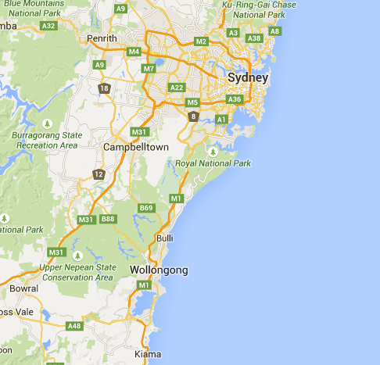

Slide 3
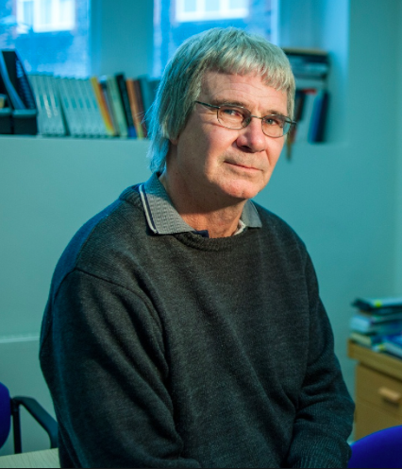

Changing paradigms

Slide 4
Psychosis as a continuum
Level of psychosis
What are these factors?
Psychotic disorder
Subclinical, “schizotypal”
none
birth
adolescence
adulthood
old age
Collip et al, schiz bull 2008; Wigman et al schiz bull 2011; Cougnard et al, Psych Med 2007; Dominguez et al 2009
Notes:
4

Slide 5
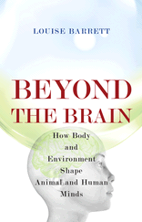
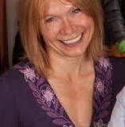
“An abnormal environment can disrupt
normal development as effectively as can a mutant gene, if not more so,
with major consequences for behavior”

Slide 6
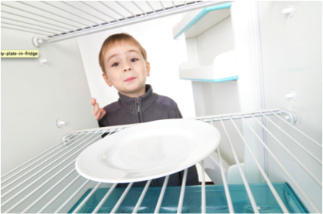
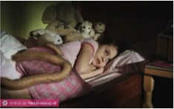
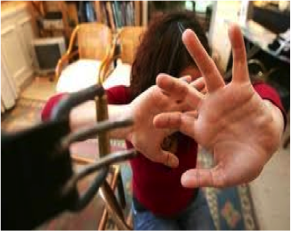
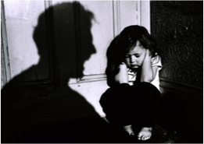

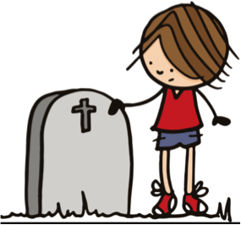
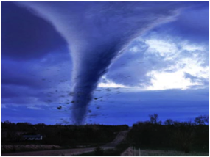

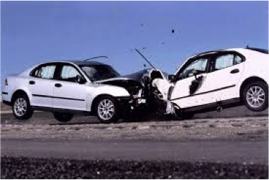

CHILDHOOD TRAUMA

Slide 7
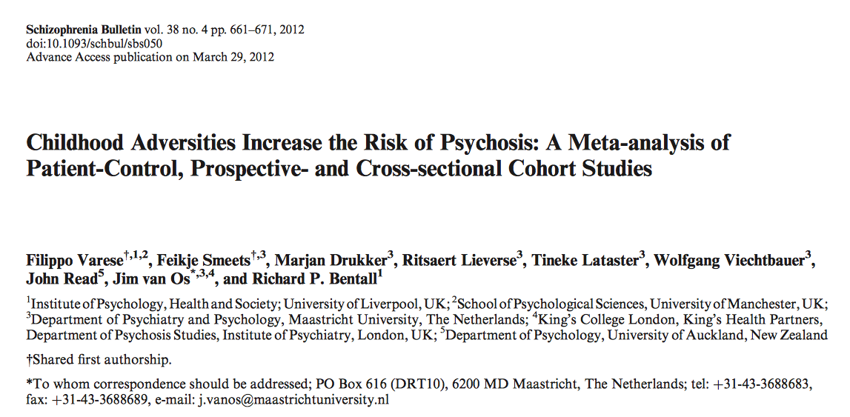
MHENS School for Mental Health and Neuroscience
Is trauma a risk factor for psychosis?
Faculty of Health, Medicine, and Life Sciences

Slide 8
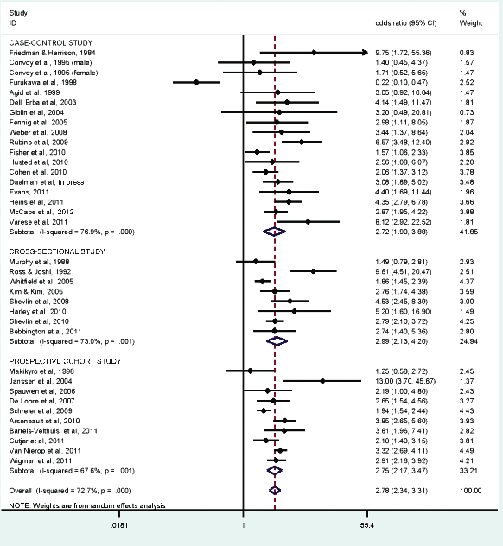
OR=2,78
(95% CI 2.34 –
3.31)

Slide 9
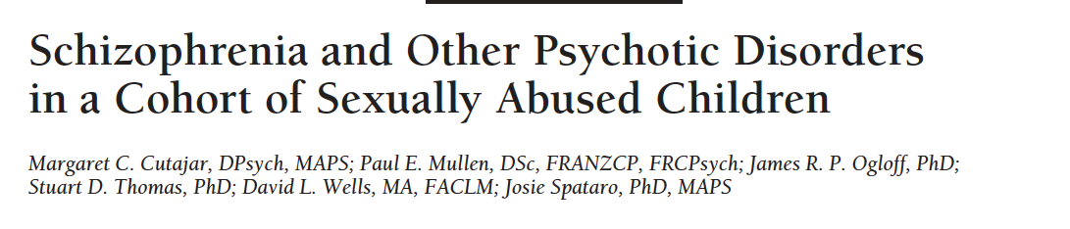
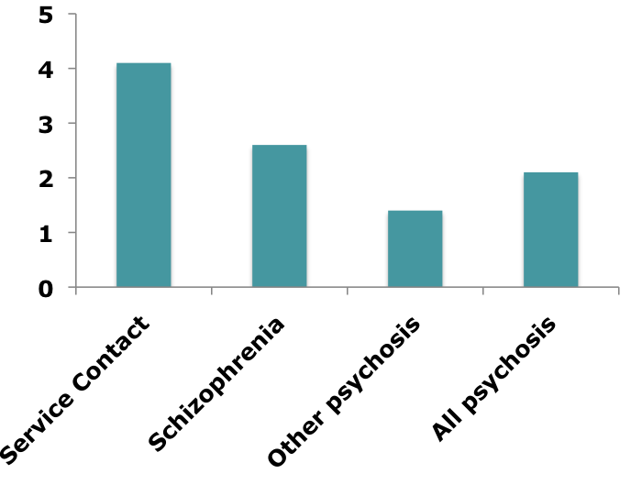
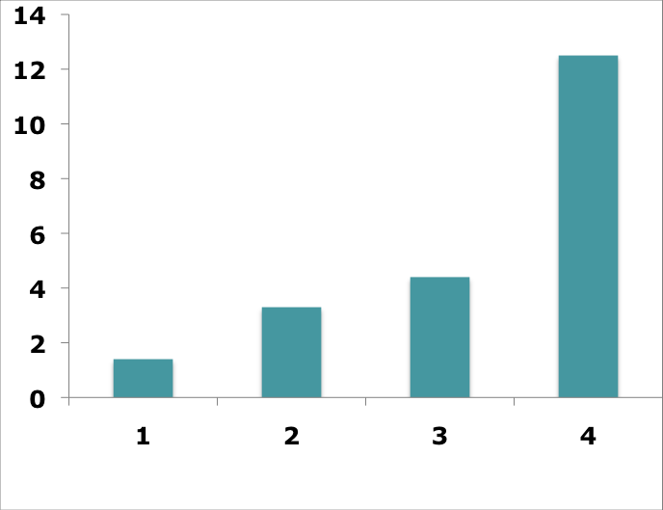
Case – control study
MHENS School for Mental Health and Neuroscience
Faculty of Health, Medicine, and Life Sciences
Arch Gen Psychiatry, 2010

Slide 10

MHENS School for Mental Health and Neuroscience
Trauma in patients with psychosis
271 Patients
227 Controls
OR= 4.57 ***
Faculty of Health, Medicine, and Life Sciences
Heins et al, Am J Psych, 2011
Notes:
Patients are more likely to have experienced trauma compared to controls. However, this is possibly due to confounding factors such as the familial environment in which the patients are growing up, the school were they go, the level of education of the parents.

Slide 11
Trauma in siblings
MHENS School for Mental Health and Neuroscience
OR= 2.60 ***
271 Patients
259 Siblings
227 Controls
OR= 4.57
Faculty of Health, Medicine, and Life Sciences
Heins et al, Am J Psych, 2011
Notes:
Therefore, we included siblings of these patients with psychosis, thus controlling for these familial factors. Still, an increased risk of trauma was found in the patients compared to the controls, showing that trauma, more than familial factors are associated to patient status.

Slide 12
Trauma and psychosis
MHENS School for Mental Health and Neuroscience
OR= 2.60 ***
OR= 1.60 *
271 Patients
259 Siblings
227 Controls
OR= 4.57
Faculty of Health, Medicine, and Life Sciences
Heins et al, Am J Psych, 2011
Notes:
If the trauma reports of the patients are valid, one would expect that siblings who share the same environment, share some of their traumatic experiences with their ill relatives, thus resulting in higher trauma scores in the siblings compared to the controls.

Slide 13
Within person associations
MHENS School for Mental Health and Neuroscience
271 Patients
259 Siblings
227 Controls
Symptoms
Symptoms
Symptoms
Faculty of Health, Medicine, and Life Sciences
Heins et al, Am J Psych, 2011
Notes:
Within-person associations. If associations between trauma and psychotic symptoms (patients – with illness) and schizotypy (siblings – at intermediate genetic risk – and controls – at average genetic risk) are positive in all three groups, genetic confounding, illness-related reporting bias or reverse causality are unlikely.

Slide 14
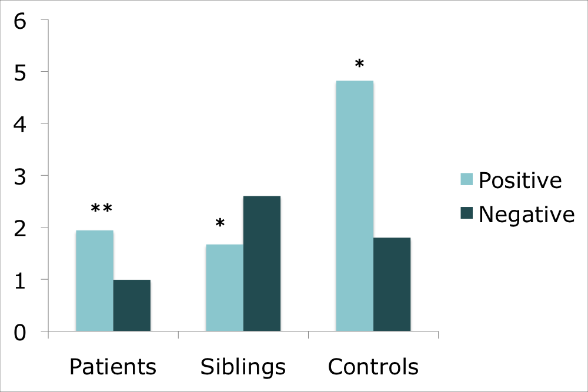
MHENS School for Mental Health and Neuroscience
Within person associations
Faculty of Health, Medicine, and Life Sciences
Heins et al, Am J Psych, 2011

Slide 15
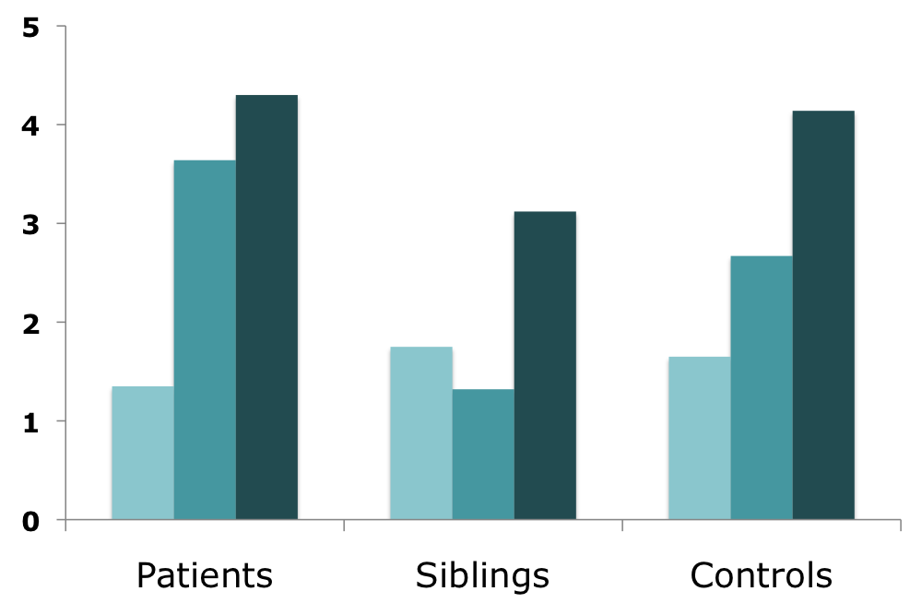
Dose - response
MHENS School for Mental Health and Neuroscience
Faculty of Health, Medicine, and Life Sciences
Heins et al, Am J Psych, 2011

Slide 16


General population study
MHENS School for Mental Health and Neuroscience
13 722
*
*
*
*
*
*
*
*
*
*
*
*
*
*
*
Faculty of Health, Medicine, and Life Sciences
Van Nierop et al, Schiz Bull, 2014
Notes:
Overall, stronger as

Slide 17
General population study
MHENS School for Mental Health and Neuroscience
13 722
Faculty of Health, Medicine, and Life Sciences
Van Nierop et al, Schiz Bull, 2014

Slide 18
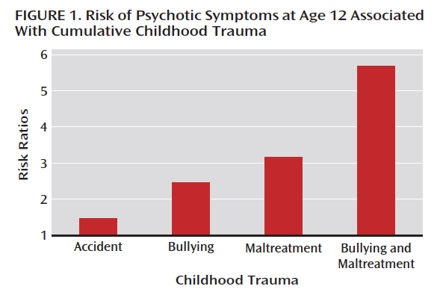
MHENS School for Mental Health and Neuroscience
Is trauma a risk factor for psychosis?
Faculty of Health, Medicine, and Life Sciences
Arsenault, Am. J. Psychiatry, 2011

Slide 19
Is it specific for psychosis?
MHENS School for Mental Health and Neuroscience
Faculty of Health, Medicine, and Life Sciences
Van Dam et al, Psych Med, 2015

Slide 20
General population
(N=6646)
Anxiety disorder
(N=1120)
Depression
(N=1577)
Psychotic disorder
(N=825)
DEPRESSION
ANXIETY
MANIA
PSYCHOSIS

Slide 21
No Symptoms
Depression only
Mania only
Anxiety only
Psychosis only
2 Clusters
3 Clusters
4 Clusters

Slide 22
General population
Van Nierop et al, Acta Scan Psych, 2015

Slide 23
General population
***
***
***
Van Nierop et al, Acta Scan Psych, 2015

Slide 24
Depression
Anxiety
Psychosis
Van Nierop et al, Acta Scan Psych, 2015

Slide 25
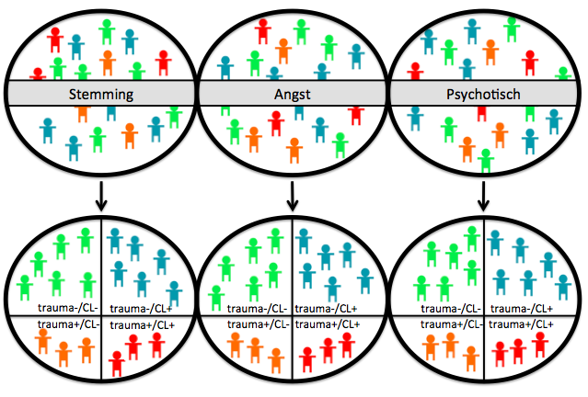
Depression
Anxiety
Psychotic

Slide 26
Patients with affective disorder
Work / income %
Relations %
Education (mean)
Clinical aspects %
Social functioning (mean)
CT-/ CL-
CT-/ CL+
CT+/ CL-
CT+/ CL+

Slide 27
Patients with anxiety disorder
Work / income %
Relations %
Education (mean)
Clinical aspects %
Social functioning (mean)
CT-/ CL-
CT-/ CL+
CT+/ CL-
CT+/ CL+

Slide 28
Patients with Psychotic disorder
Work / income %
Relations %
Education (mean)
GAF (mean)
PANSS (mean)
WHO Quality of Life (mean)
CT-/ CL-
CT-/ CL+
CT+/ CL-
CT+/ CL+

Slide 29
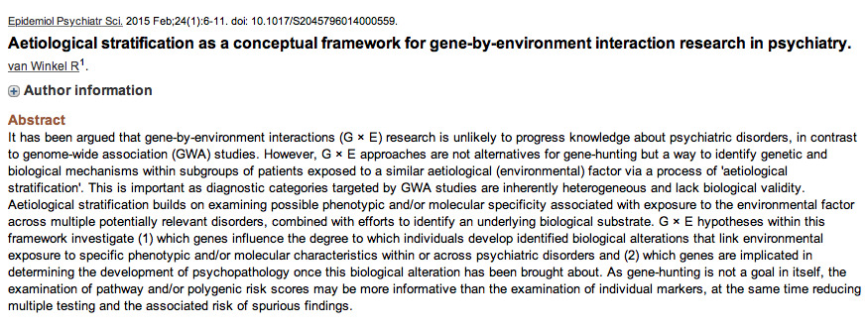
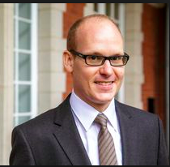

Slide 30



DEPRESSION
ANXIETY
PSYCHOSIS
ENVIRONMENTAL STRATIFICATION
Patiets exposed
to trauma

Slide 31
MHENS School for Mental Health and Neuroscience
What is the mechanism?
+
–
Faculty of Health, Medicine, and Life Sciences

Slide 32
MHENS School for Mental Health and Neuroscience
Environment – environment interaction?
Environment
Environment
Psychosis
Faculty of Health, Medicine, and Life Sciences

Slide 33
MHENS School for Mental Health and Neuroscience
Sensitization?
Sensitization
Faculty of Health, Medicine, and Life Sciences
Collip et al, 2008, Schiz Bull

Slide 34
MHENS School for Mental Health and Neuroscience
Sensitization?
Sensitization
Faculty of Health, Medicine, and Life Sciences
Collip et al, 2008, Schiz Bull

Slide 35
MHENS School for Mental Health and Neuroscience
Trauma x cannabis?
Greek Birthcohort; N= 3500
Cannabis
Age 7:
No childhood trauma
Childhood trauma
Age 19:
Psychotic symptoms (CAPE)
Faculty of Health, Medicine, and Life Sciences
Konings et al, Psych Med 2012

Slide 36
MHENS School for Mental Health and Neuroscience
Trauma x cannabis
CAPE
score
Maltreatment Age 7
Faculty of Health, Medicine, and Life Sciences
Konings et al, Psych Med 2012

Slide 37
Trauma <- > life events
MHENS School for Mental Health and Neuroscience
Nemesis study, 4848 general population
Childhood trauma
T0
No Cannabis
Cannabis
T1/T2
Psychosis
Faculty of Health, Medicine, and Life Sciences
Konings et al, Psych Med 2012

Slide 38
MHENS School for Mental Health and Neuroscience
Trauma x cannabis
% T1/T2 Psychosis
Childhood trauma
Faculty of Health, Medicine, and Life Sciences
Konings et al, Psych Med 2012

Slide 39
Trauma <- > life events
MHENS School for Mental Health and Neuroscience
GROUP study, 1119 patients / 589 controls
Urbanicity
No Trauma
Trauma
T0
Case / control
Faculty of Health, Medicine, and Life Sciences
Frissen et al, SPPE, 2015

Slide 40
MHENS School for Mental Health and Neuroscience
Trauma x urbanicity
OR
Level of urbanicity
Faculty of Health, Medicine, and Life Sciences
Frissen et al, SPPE, 2015

Slide 41
Trauma <- > life events
MHENS School for Mental Health and Neuroscience
EDSP study, 2437 adolescents ranging from 17 to 24 years
No psychosis
T0
Life events
T2
No childhood trauma
Childhood trauma
T3
Psychosis
Faculty of Health, Medicine, and Life Sciences
Lataster J et al, Acta Psych Scan, 2012

Slide 42
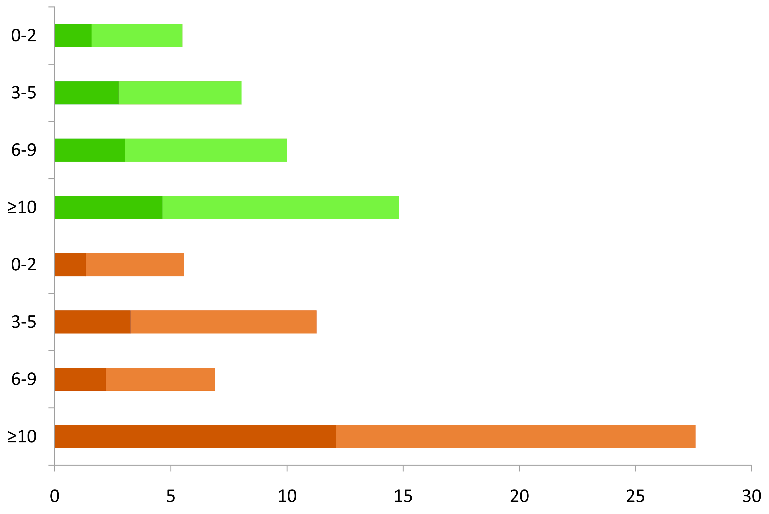
Trauma <- > life events
Nº later life adverse events
n=192
χ2=4.59; p=.032
No early life adversity
n=336
n=341
n=248
n=76
n=158
Early life adversity
n=186
n=185
Percentage with psychotic symptoms / impairment
Faculty of Health, Medicine, and Life Sciences
Lataster J et al, Acta Psych Scan, 2012

Slide 43
Trauma <- > life events
Nº later life adverse events
n=192
χ2=4.59; p=.032
No early life adversity
n=336
n=341
n=248
n=76
n=158
Early life adversity
n=186
n=185
Percentage with psychotic symptoms / impairment
Faculty of Health, Medicine, and Life Sciences
Lataster J et al, Acta Psych Scan, 2012

Slide 44
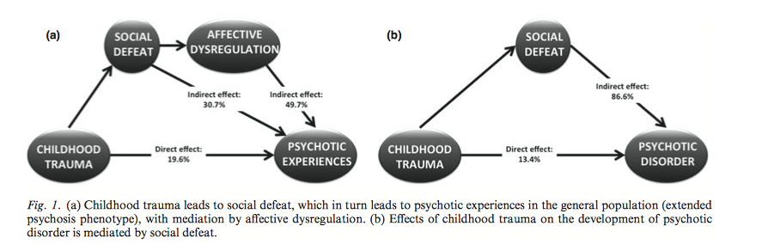
Psychological mechanisms
Social defeat: loss of self-confidence, being hopeless, feeling less than other people
Affective dysregulation
Van Nierop et al, Acta Pscych Scan, 2014

Slide 45
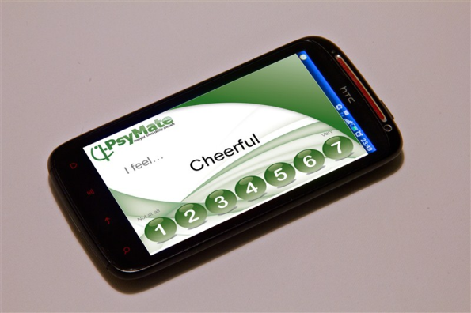
The Experience Sampling Method
Beep 1
Beep 2
DAY 1
Beep 3
DAY 2
Beep 4
DAY 3
Beep 5
DAY 4
(day 4 in detail)
Beep 6
DAY 5
Beep 7
DAY 6
Beep 8
10 times a day
6 consecutive days
at random moments
Beep 9
Beep 10
Myin-Germeys et al, 2009; Wichers et al., 2009; Delespaul, 1995

Slide 46
Emotional Reactivity to stress
Daily stress
Mood
Faculty of Health, Medicine, and Life Sciences

Slide 47
Emotional reactivity to daily life stress
MHENS School for Mental Health and Neuroscience
42 Patients, β=0.22
47 Relatives, β=0.09
49 Controls, β=0.05
Negative affect
STRESS
Faculty of Health, Medicine, and Life Sciences
Myin-Germeys et al., Arch Gen Psych 2001

Slide 48
Activity-related stress and psychosis
MHENS School for Mental Health and Neuroscience
Daily stress
Psychotic
Symptoms
20
18
16
Psychosis intensity
Patients, β=0.45
14
Relatives, β=0.16
Controls, β=0.02
12
10
8
1
2
3
4
5
6
7
Increase in activity-related stress
Faculty of Health, Medicine, and Life Sciences
Myin-Germeys et al., Psych Med 2005

Slide 49
Childhood trauma & stress-reactivity
In a general population sample of 90 frequent attenders
of the general practitioner
Daily stress
Mood
32%
Trauma
sexual trauma
physical trauma
Faculty of Health, Medicine, and Life Sciences
Glaser et al., j. Psychosomatic Med 2006

Slide 50
Childhood trauma & stress-reactivity
Increase
NA
Activity-related stress
Faculty of Health, Medicine, and Life Sciences
Glaser et al., j. Psychosomatic Med 2006

Slide 51
Childhood trauma & stress-reactivity
Increase
NA
Activity-related stress
Faculty of Health, Medicine, and Life Sciences
Glaser et al., j. Psychosomatic Med 2006

Slide 52
Childhood trauma & stress-reactivity
In 58 patients with psychosis
Daily stress
Mood
Trauma
Sexual abuse
Physical abuse
Psychological abuse
Emotional neglect
Faculty of Health, Medicine, and Life Sciences

Slide 53
MHENS School for Mental Health and Neuroscience
Childhood trauma & emotional stressreactivity
NA
STRESS
Faculty of Health, Medicine, and Life Sciences
Lardinois et al, Acta Psych Scand, 2010

Slide 54
MHENS School for Mental Health and Neuroscience
Childhood trauma & psychotic stress-reactivity
Psychose
STRESS
Faculty of Health, Medicine, and Life Sciences
Lardinois et al, Acta Psych Scand, 2010

Slide 55
LE & stress-reactivity
Daily stress
Mood
Life events
Faculty of Health, Medicine, and Life Sciences

Slide 56
LE & stress-reactivity
NA
STRESS
Faculty of Health, Medicine, and Life Sciences
Myin-Germeys et al, Psych Med 2003

Slide 57
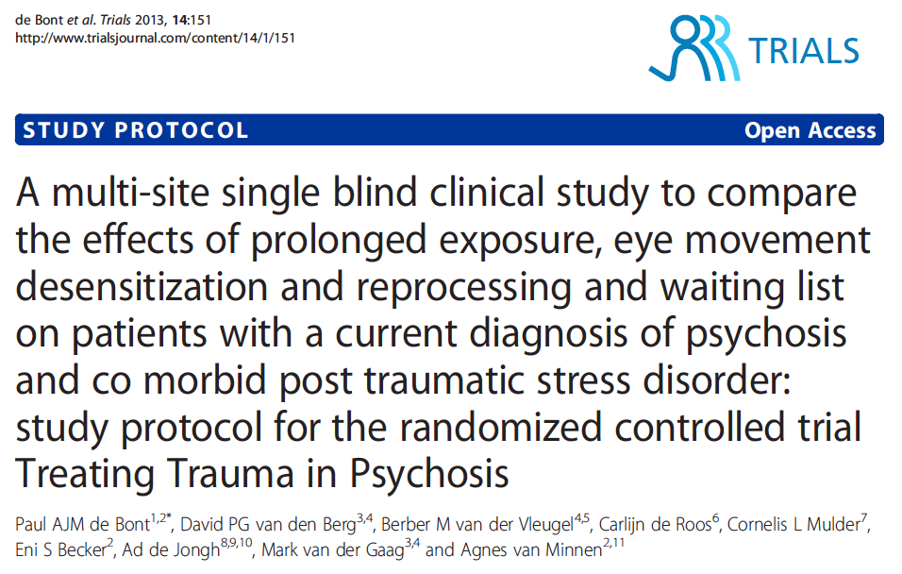
Need for care
Trauma treatment?
Prognosis

Slide 58
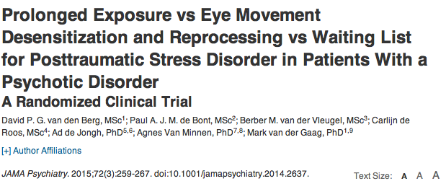

Slide 59

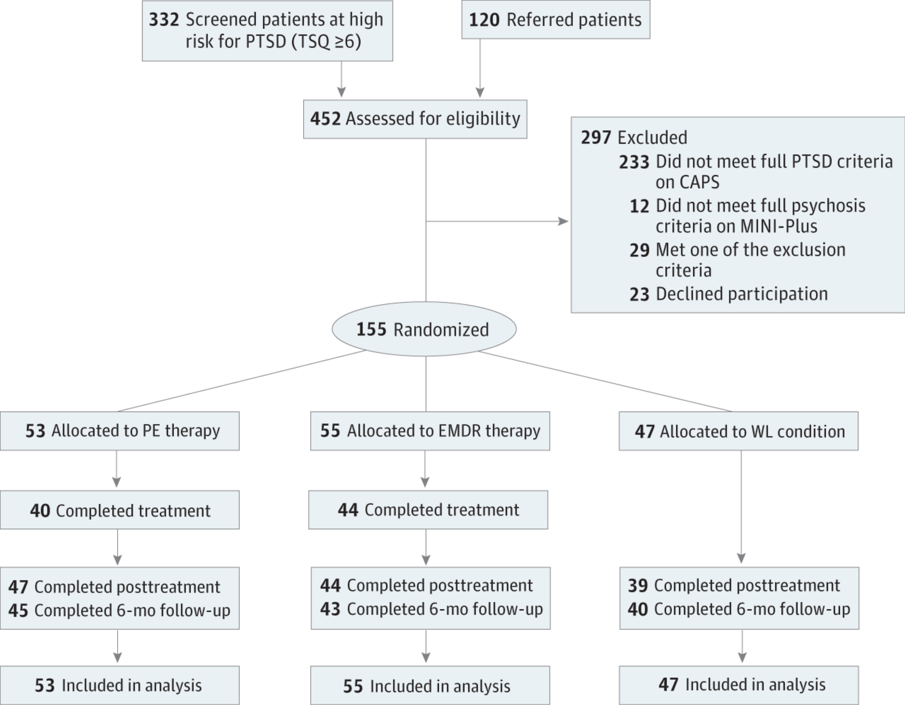

Slide 60
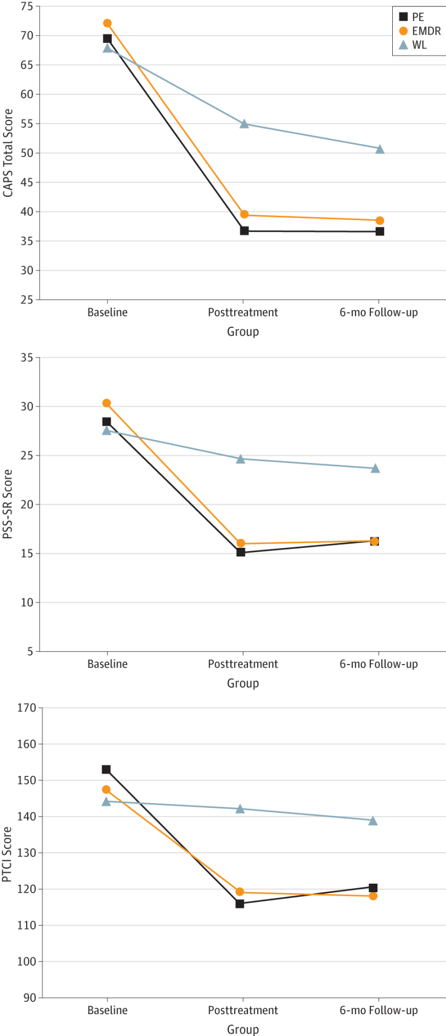
Symptom severity
Self report
Trauma cognitions

Slide 61
MHENS School for Mental Health and Neuroscience
Alternative treatments
ESM feedback
TAU + ESM + feedback
Baseline
ESM
HDRS IDS
Pseudo-interventie
Post
ESM HDRS IDS
Depressive symptoms
FU 1,2,3 &
6 months
TAU + ESM
Controle
TAU
Faculty of Health, Medicine, and Life Sciences
Kramer et al, World Psychiatry 2014

Slide 62
MHENS School for Mental Health and Neuroscience
Behavioural activation in real life
In depression
Faculty of Health, Medicine, and Life Sciences
Kramer et al, World Psychiatry 2014

Slide 63
MHENS School for Mental Health and Neuroscience
Behavioural activation -> results
Self-report depression (IDS-SR)
Faculty of Health, Medicine, and Life Sciences
Kramer et al, World Psychiatry 2014

Slide 64
MHENS School for Mental Health and Neuroscience
Behavioural activation -> results
Rated depression (HAMILTON)
Faculty of Health, Medicine, and Life Sciences
Kramer et al, World Psychiatry 2014

Slide 65
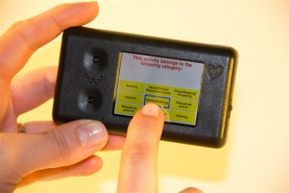

ACT in daily life
Regular ACT-training
Briefing
4-week additional ACT in Daily Life Training
Debriefing
Week 1: 3-day training
Evaluation
Week 2: 3-day training
Evaluation
Week 3: 3-day training
Evaluation
Week 4: 3-day training
Evaluation
Notes:
Ok, so we looked at the three different ingredients of the ACT in Daily Life Training. Time to look at the bigger picture, starting top down with an overview of the ACT in Daily Life Training.
ACT-training mandatory
Briefing, 4 week AiDLT, debriefing.
AiDLT consists of; 4-weeks, 3 days daily training, followed by a short evalution.

Slide 66
ACT in daily life -> training day
Short-questionnairre
(3 minutes)
ACT-Metaphor / Awareness exercise
T1
T2
T3
T4
T5
T6
T7
T8
T9
T10
Morning-exercise: Values
Evening-exercise: Commit-ment
ESM-I: 10 times a day.
Morning ACT-exercise
Afternoon ACT-exercise
Evening ACT-exercise
Standard-exercise
ACTion-exercise
Notes:
Let us now zoom in on a training-day of the ACT in Daily Life Training, to get an idea of the design.
Morning exercise; 3 values, which one are you going to invest in today?
Evening exercise; did you invest in your value today?
ESM periode; 10 times a day the PsyMate will randomly give a signal, the patient than has to fill in a short questionaire, followed by an illustrated ACT-metaphor or a short awareness exercise.
Parralel, the patient will do at least three ACT-exercises per day (morning, afternoon, evening). These can be standard-exercises, or ACTion-exercises. One can activite standard-act exercises at all times, the ACTion-exercises are ment be used only as an event-related exercise, when one notices negative experiences.

Slide 67
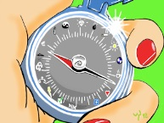
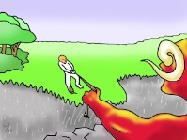
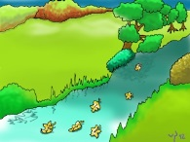
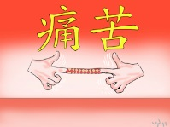
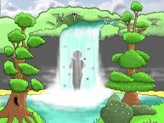
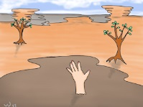
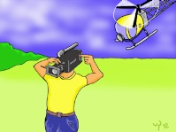
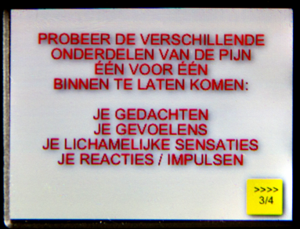
ACT in daily life -> PsyMate
PsyMate Menu
Morning (values)
ACT-standard
ACT-Metaphor
ACTion-exercise
Evening
(commitment)
Accept
Defusion
Mindfulness
Accept
Defusion
1. Struggle
2. Invite pain
3. Obstakles
4. Dark-side
1. Observe
2. Clouds
3. Zoom out
4. Mind-control
1. Senses
2. Breathing
3. Bodyscan
4. Grounding
1. Compassion
2. Explore
3. Fight or Flight
1. Repeat
2. Step-back
3. Appreciate
Notes:
SHORT
We will now look a little bit more closely at which exercises and methaphors that will be offered to the patient in the ACT in Daily Life Training. We will do this, by following the PsyMate-Menu.
Morning exercise (visual cue, compas) & Evening exercise (visual cue, compas).
Standard ACT-exercises: Accept, Defusion, Mindfulness, four exercises per component. (Onscreen exercises, Dutch)
ACTion-ercise: Accept, Defusion, three exercises per component.
ACT-metaphor; Acceptance, Defusion, three illustraed metaphors per component.
Sofar the conceptual presentation of the ACT in Daily Life Training, now let’s look at the research.

Slide 68

MHENS School for Mental Health and Neuroscience
To conclude
Faculty of Health, Medicine, and Life Sciences

Slide 69
MHENS School for Mental Health and Neuroscience
To conclude
Paradigm shift
History of interactions / learning by consequences
New treatment / prevention strategies
Faculty of Health, Medicine, and Life Sciences

Slide 70
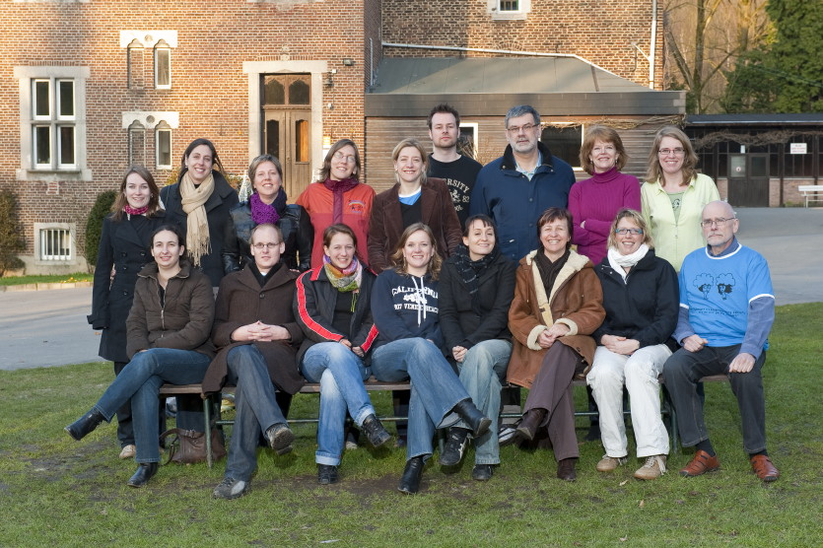

Thanks to:
Funding:
European Research Council (ERC consolidator grant)
Dutch Research Council
NARSAD
Health Foundation Limburg
Starting October 1st

